Slide 1

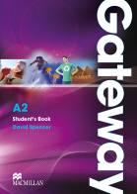

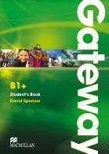
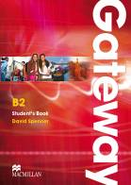



How to Teach
Secondary Students
(without losing your sanity in the process)
Liam Tyler

Slide 2
Teens: the good, the bad, and the just plain difficult…
shocking
frustrating
interesting
rewarding
stressful
fun
stimulating
difficult
exhausting
challenging

Slide 3
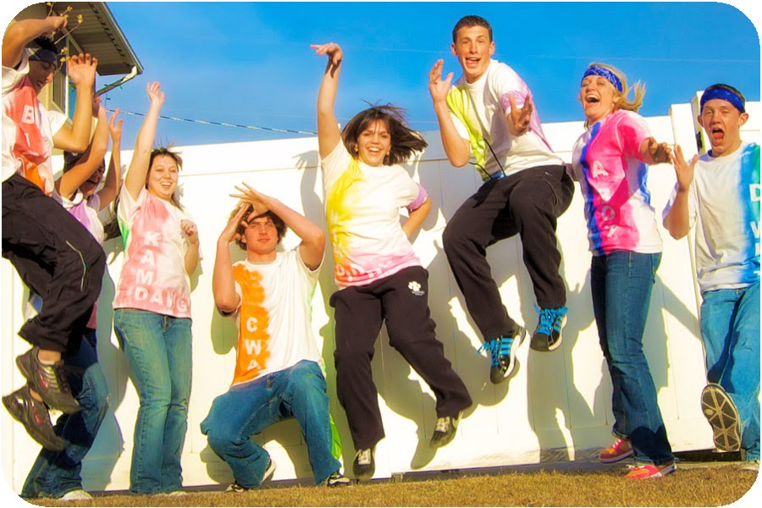
‘Teenagers can be the best learners of a language!’
Penny Ur, EFL author

Slide 4
A. How to start an English lesson

Slide 5
Sentence Hangman
_ / _ _ _ _ / _ _ _ _ _ _ _ _ / _ _ _ _ _ _.
1 point for guessing a letter correctly.
5 points for guessing a word correctly.
10 extra points for finishing the sentence.

Slide 6
Sentence Hangman
_ / _ _ _ _ / _ _ _ _ _ _ _ _ / _ _ _ _ _ _.
BUT
-1 point for guessing a letter incorrectly.
-5 points for guessing a word incorrectly.
-10 points for an incorrect sentence.

Slide 7
Sentence Hangman
_ / _ _ _ _ / _ _ _ _ _ _ _ _ / _ _ _ _ _ _.
Team A: The letter A.

Slide 8
Sentence Hangman
_ / _ _ _ _ / _ _ _ _ _ _ _ _ / _ _ _ _ _ A
Team A: The letter A.
Teacher: One point.

Slide 9
Sentence Hangman
_ / _ _ _ _ / _ _ _ _ _ _ _ _ / _ _ _ _ _ A
Team B: The letter S.

Slide 10
Sentence Hangman
_ / _ _ _ _ / _ _ S _ _ _ _ _ / _ _ S S _ A
Team B: The letter S.
Teacher: One point.

Slide 11
Sentence Hangman
_ / _ _ _ _ / _ _ S _ _ _ _ _ / _ _ S S _ A
Team A: The letter I.

Slide 12
Sentence Hangman
I / _ _ _ _ / _ I S I _ I _ _ / _ _ S S I A
Team A: The letter I.
Teacher: Six points.

Slide 13
Sentence Hangman
I / _ _ _ _ / _ I S I _ I _ _ / _ _ S S I A
Team B: The letter M.

Slide 14
Sentence Hangman
I / _ _ _ _ / _ I S I _ I _ _ / _ _ S S I A
Team B: The letter M.
Teacher: No. Minus one.

Slide 15
Sentence Hangman
I / _ _ _ _ / _ I S I _ I _ _ / _ _ S S I A
Team A: Two words. ‘visiting’ and ‘Russia’.

Slide 16
Sentence Hangman
I / _ _ _ _ / V I S I T I N G / R U S S I A
Team A: Two words. ‘visiting’ and ‘Russia’.
Teacher: Correct. Ten points.
(At the moment, A has 17 points, B has 0)

Slide 17
Sentence Hangman
I / _ _ _ _ / V I S I T I N G / R U S S I A
Team B: We think the second word is ‘love’.

Slide 18
Sentence Hangman
I / L O V E / V I S I T I N G / R U S S I A
Team B: We think the second word is ‘love’.
Teacher: Correct. Fifteen points.
But Team A wins 17-15.

Slide 19
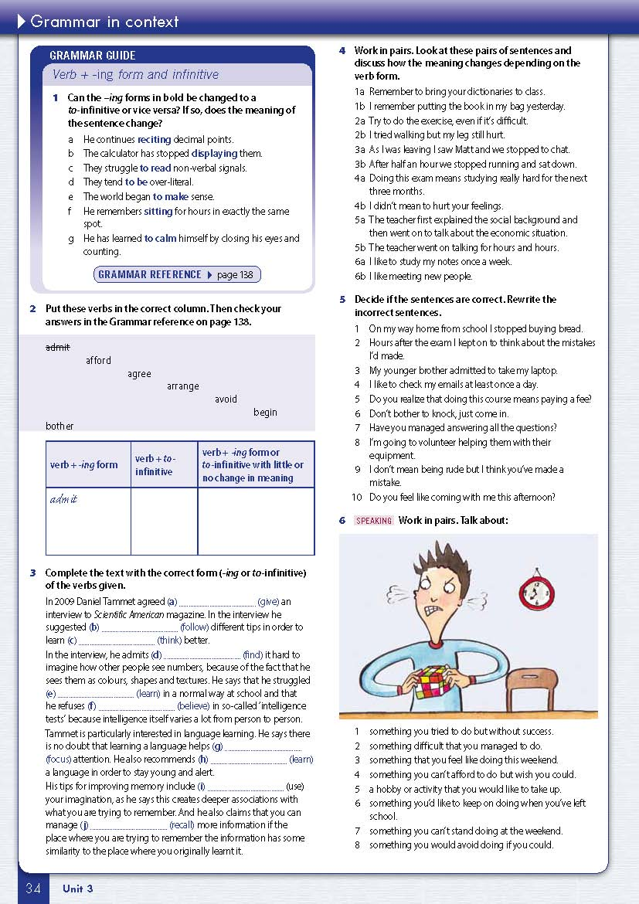

Slide 20
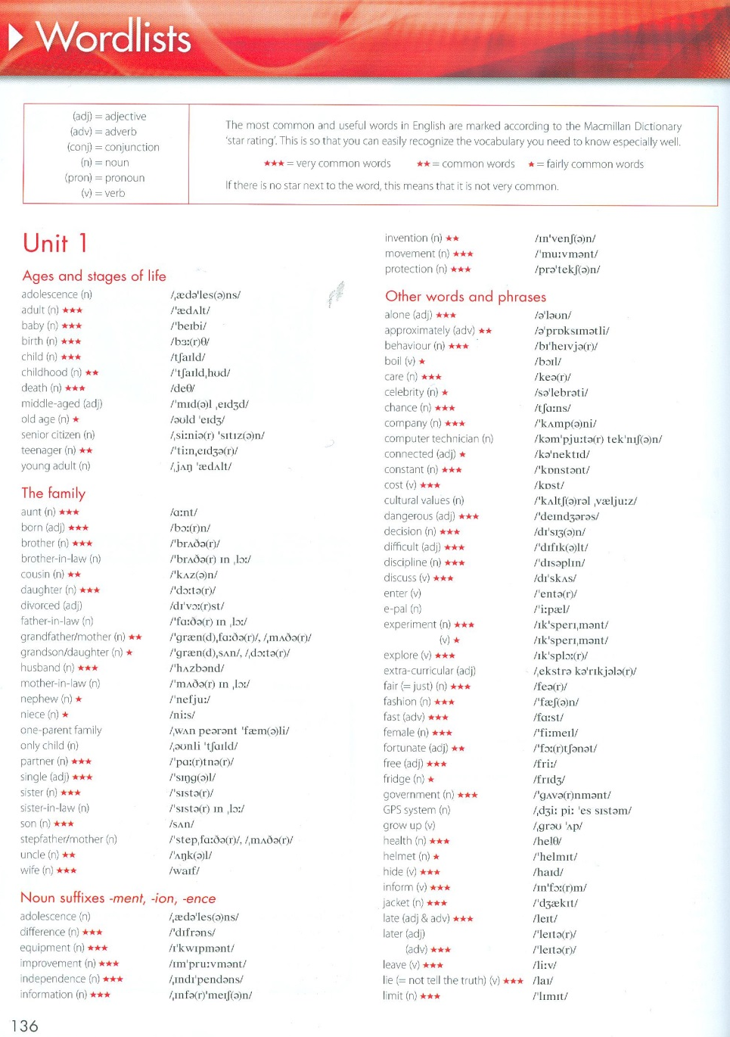
Vocabulary bingo

Slide 21
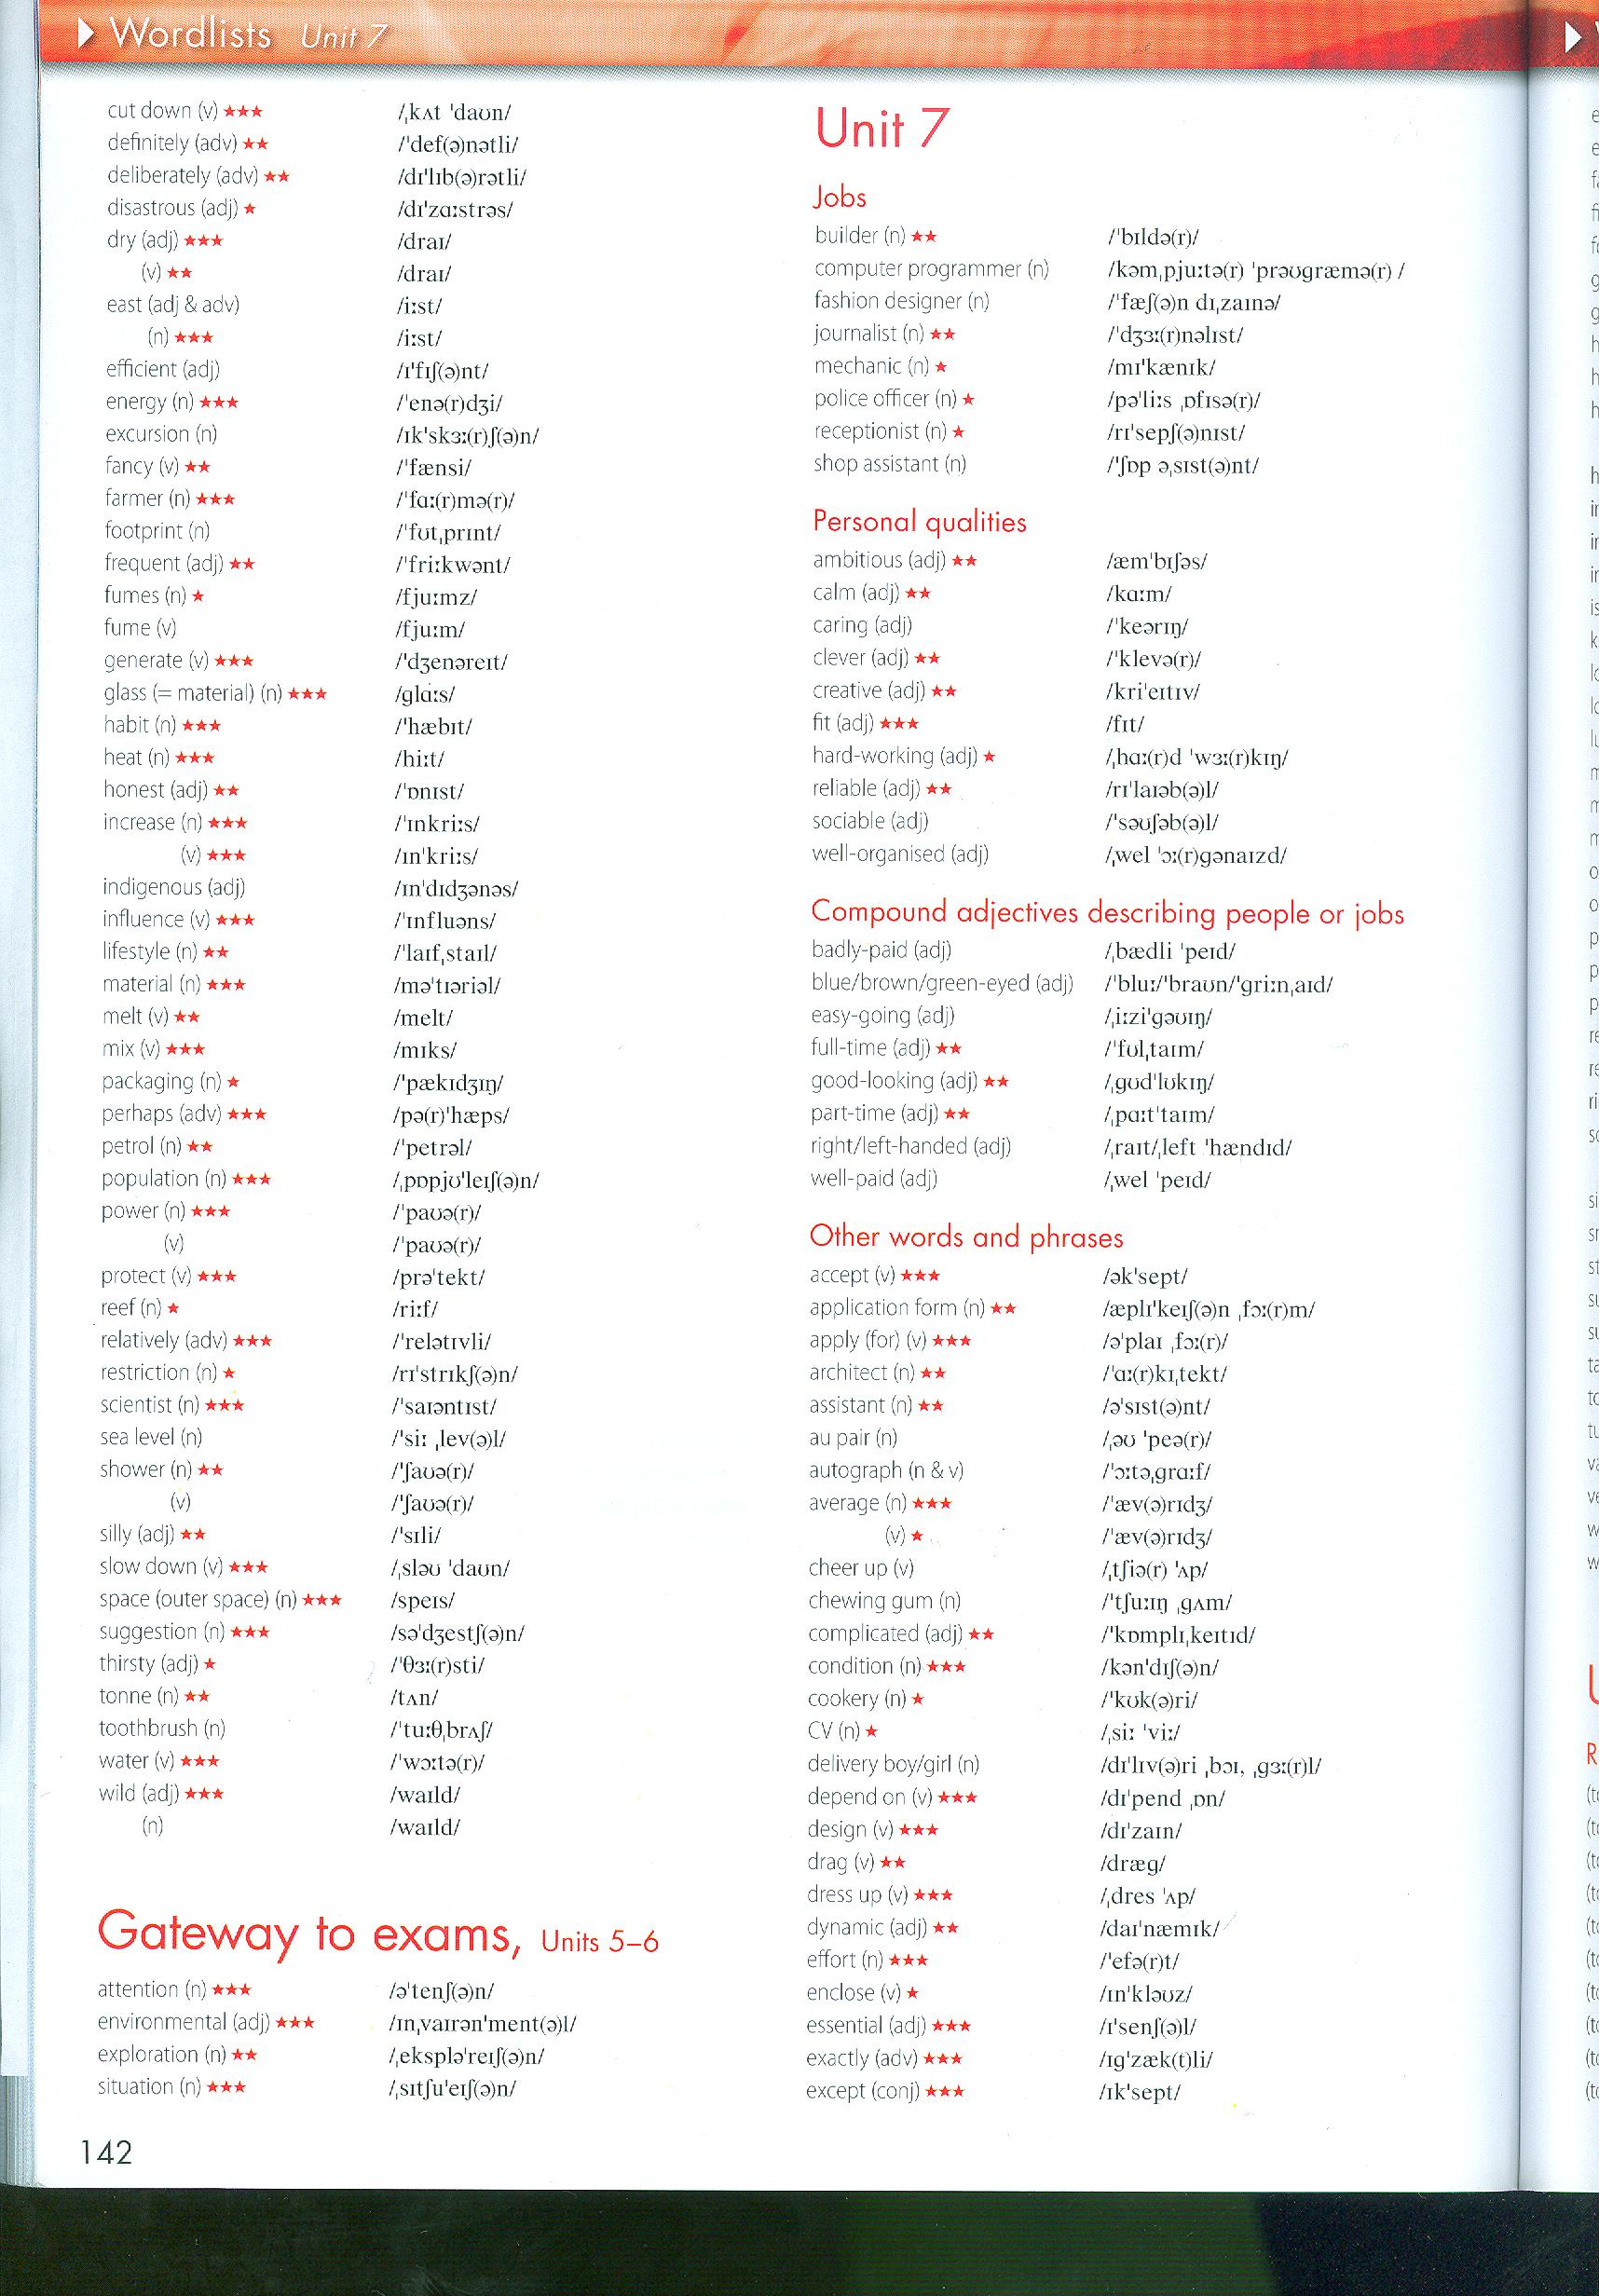
Vocabulary bingo
Choose a set of vocabulary to revise.

Slide 22
Students take a piece of paper and divide it into 6 sections (more if you like).

Slide 23
The students choose any 6 words from the list to write in the spaces.
Student A writes…
caring | fit | creative
sociable | part-time | au pair
Student B writes…
reliable | easy-going | clever
mechanic | fit | good-looking

Slide 24
Collect, shuffle and redistribute the paper.
Student A
caring | fit | creative
sociable | part-time | au pair
Student B
reliable | easy-going | clever
mechanic | fit | good-looking

Slide 25
Collect, shuffle and redistribute the paper.
Student A
reliable | easy-going | clever
mechanic | fit | good-looking
Student B
caring | fit | creative
sociable | part-time | au pair

Slide 26
The teacher now reads definitions of words chosen randomly from the list….
Teacher: ‘someone or something you can trust or believe.’
Student A
reliable | easy-going | clever
mechanic | fit | good-looking
Student B
caring | fit | creative
sociable | part-time | au pair

Slide 27
If a student hears a definition which matches one of their words, they cross it off the list.
Teacher: ‘someone or something you can trust or believe.’
Student A
reliable | easy-going | clever
mechanic | fit | good-looking
Student B
caring | fit | creative
sociable | part-time | au pair

Slide 28
Continue with definitions of words from the list.
The first student to cross off all the words on the list shouts ‘bingo’!
The teacher then checks the list with the class.
Student A – ‘bingo!’
reliable | easy-going | clever
mechanic | fit | good-looking
Student B
caring | fit | creative
sociable | part-time | au pair

Slide 29
B. How to survive the last 10 minutes of a lesson / How to rescue a lesson that is dying

Slide 30
B. How to survive the last 10 minutes of a lesson / How to rescue a lesson that is dying
Use activities like the ones we’ve just seen!

Slide 31
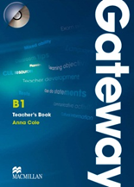

Slide 32
Lesson planning – have a ‘Plan B’
Typical plan:
Warmer (10 mins.)
Book grammar/vocab. exs. 1-4 (30 mins.)
Role-play based on grammar (10 mins.)
Song (10 mins.)

Slide 33
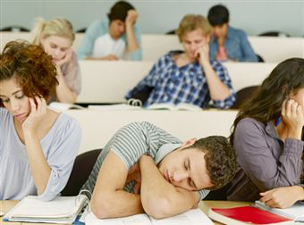
Lesson planning – have a ‘Plan B’
Typical plan:
Warmer (10 mins.)
Book grammar/vocab. exs. 1-4 (30 mins.)
Role-play based on grammar (10 mins.)
Song (10 mins.)

Slide 34
Lesson planning – have a ‘Plan B’
Typical plan:
Warmer (10 mins.)
Book grammar/vocab exs. 1-4 (30 mins.)
Role-play based on grammar (10 mins.)
Song (10mins.)
Rescuers:
Vocab. bingo
Sentence hangman
………

Slide 35
G is for…….
GRAMMAR!

Slide 36
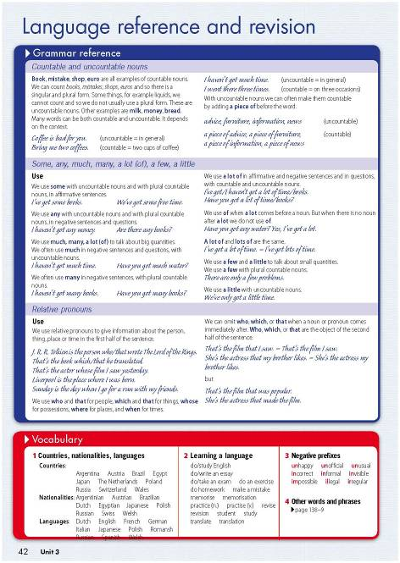
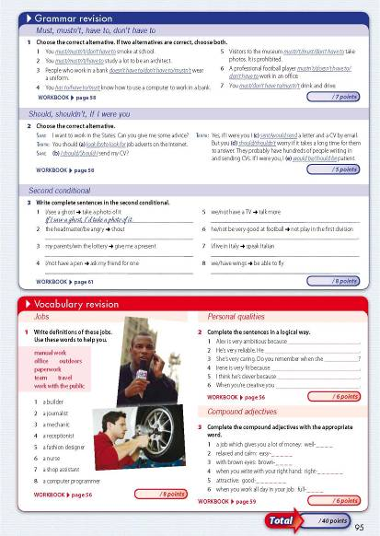
Notes:
The target grammar in each unit is given meaningful context through the reading and listening texts. Using a guided discovery approach, students follow the questions to work out the use and form of the grammar in question with contextual hints to help them along.
Students are directed to the Language Reference Section at the end of every unit to check their findings and grammatical hypotheses. These reference pages bring together all the grammar and vocabulary taught in the unit, making it much easier for student to revise and prepare for exams.

Slide 37

C. How to correct grammar exercises
(without students falling asleep)

Slide 38
DON’T ask students one by one in a set order. Ask in random order to keep them on their toes.
DON’T just ask for the answer. Ask them to explain WHY it’s the answer.
If a student answers in a soft voice, DON’T move closer to them – move further away so they have to speak up.
For variety, YOU answer the questions (and get a few wrong to test them).
If the exercise was for homework and someone didn’t do it, they still have to answer NOW.

Slide 39
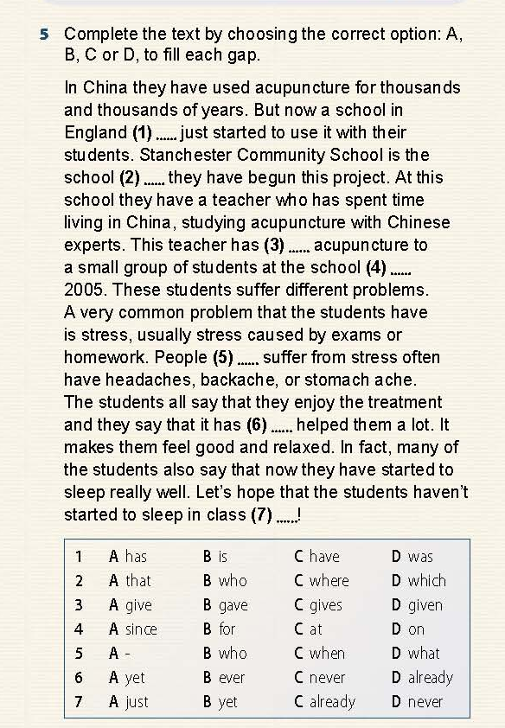
6) Don’t correct them right away – try self-correction
Students:
A
A
D
A
B
D
C
Teacher:
‘Look again – you have 2 mistakes to change’

Slide 40
6) Don’t correct them right away – try self-correction
Students (new answers):
A
A → C
D
A
B
D
C → B
Teacher:
‘Now they are all correct!’

Slide 41
D. How to encourage teenage students to speak in English

Slide 42

Motivation - the most important factor:
Substitute long- and mid-term motivation by creating in students the immediate desire to do an activity.
Notes:
You need to get students interested about completing things now!! Immediate motivation

Slide 43
Spot the difference

Slide 44


Slide 46
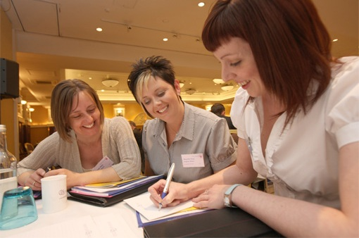

Slide 48
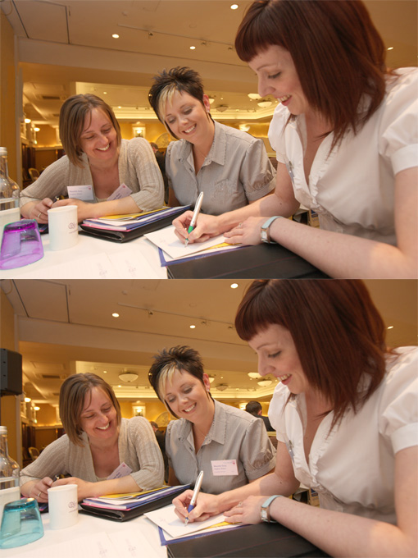

Slide 49
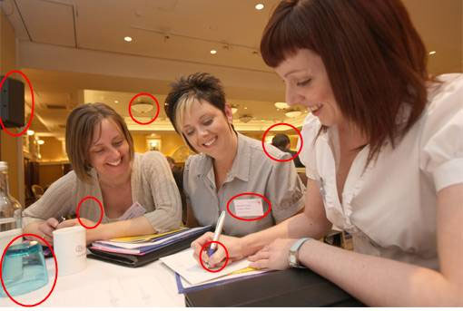

Slide 50
D. How to encourage teenage students to speak in English (continued)
Other factors to bear in mind:
Correction – listening to WHAT teenagers say, not just HOW they say it.

Slide 51
What’s wrong with this?
Teacher: ‘How was your weekend? Did you go to the party?’
Student: ‘Something very unpleasant came out and I couldn’t go to the party.’
Teacher: ‘Something very unpleasant came UP, not came OUT.’
Student: ‘Oh, sorry.’

Slide 52
A better version…
Teacher: ‘How was your weekend? Did you go to the party?’
Student: ‘Something very unpleasant came out and I couldn’t go to the party.’
Teacher: ‘Oh, I’m sorry to hear that, I hope it wasn’t anything too serious?’
Student: ‘Well, I had some problems with my dog…. ’

Slide 53
‘The greatest mistake
(if oral ability is the aim)
is for the learner not to speak at all.’
from the introduction to
Games for language learning - Wright, Betteridge and Buckby, CUP

Slide 54
D. How to encourage teenage students to speak in English (continued)
Other factors to bear in mind:
2. ‘Task Avoidance Behaviour’

Slide 55
Task avoidance: reasons and solutions
It’s not interesting
Take a new / engaging approach

Slide 56
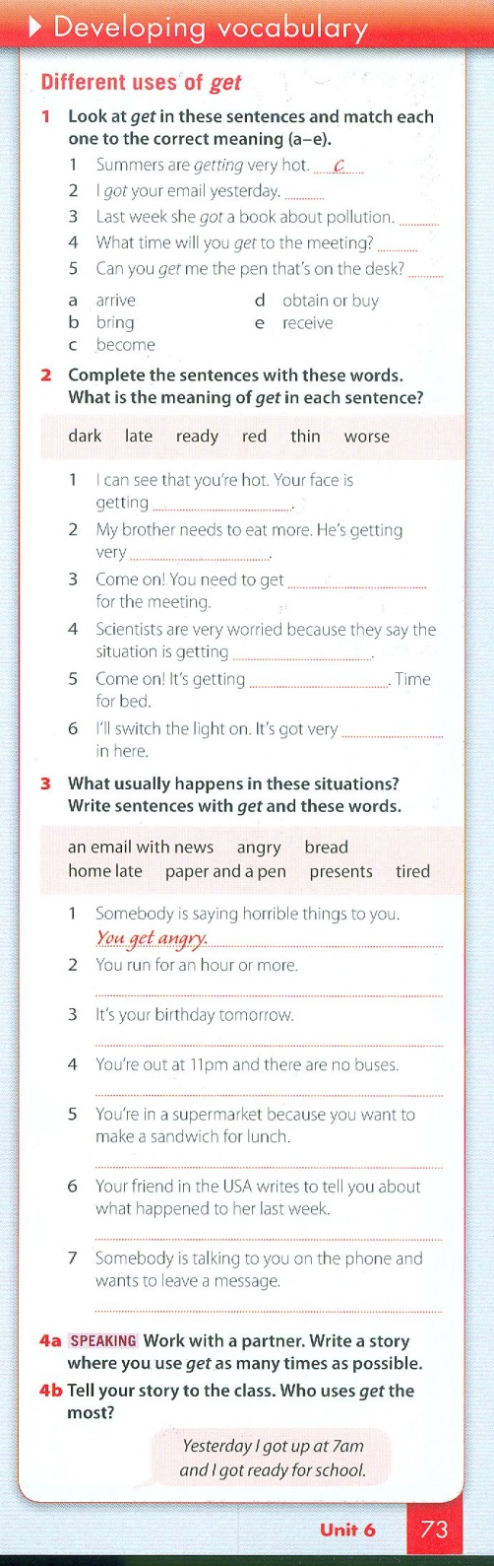

The students are bored: make it engaging / varied

Slide 57
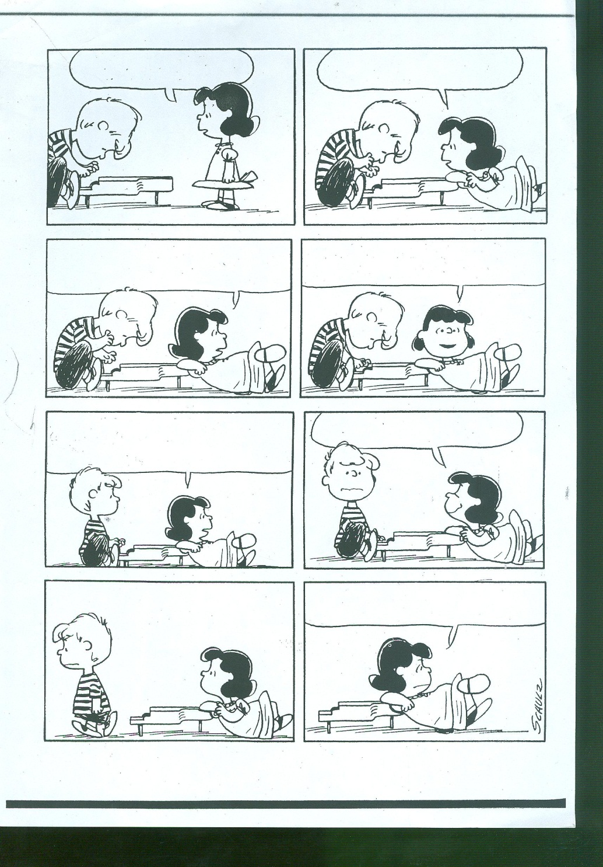

Slide 58
D. How to encourage teenage students to speak in English (continued)
Other factors to bear in mind:
3. Making it engaging through ‘personalisation’

Slide 59
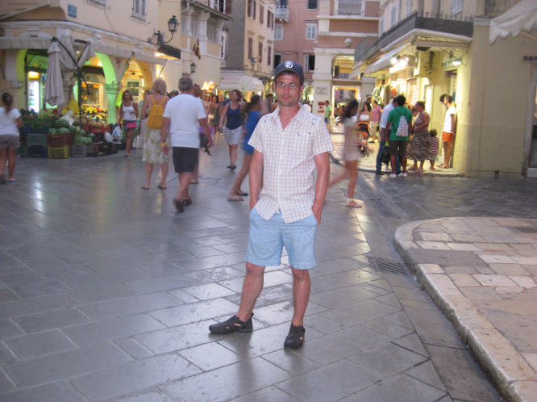
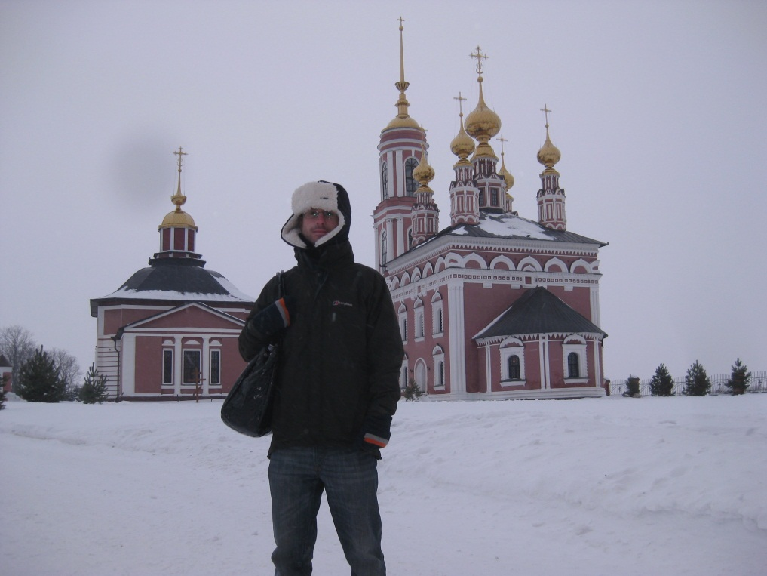
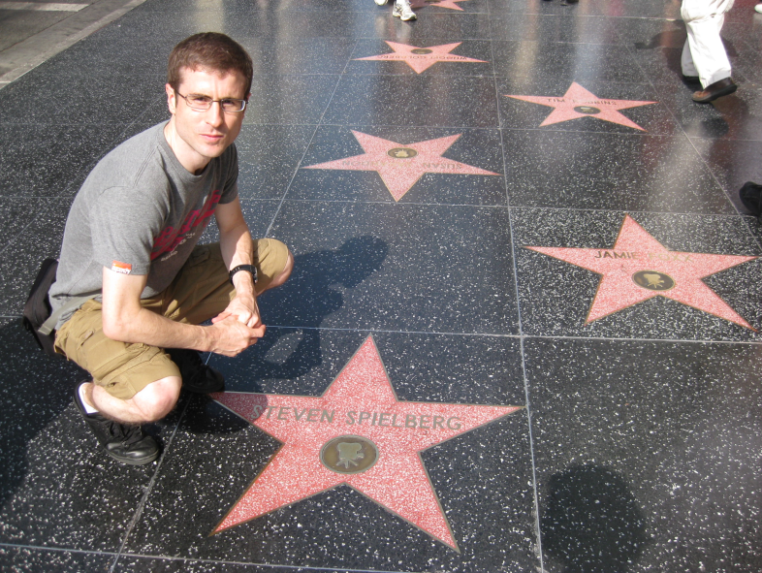
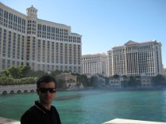
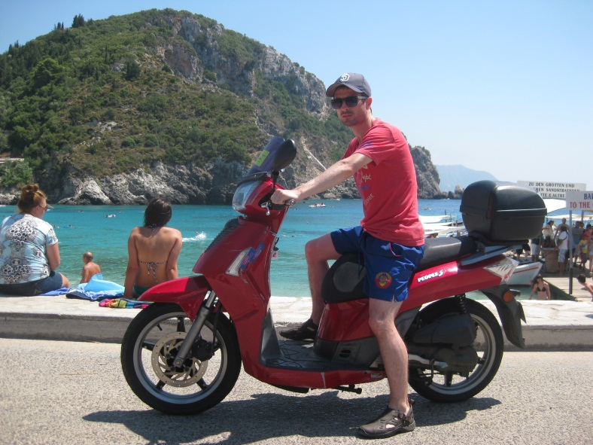


Slide 60
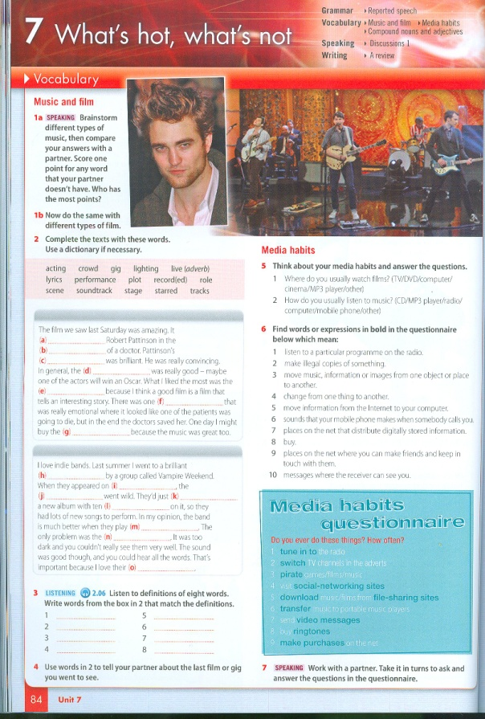
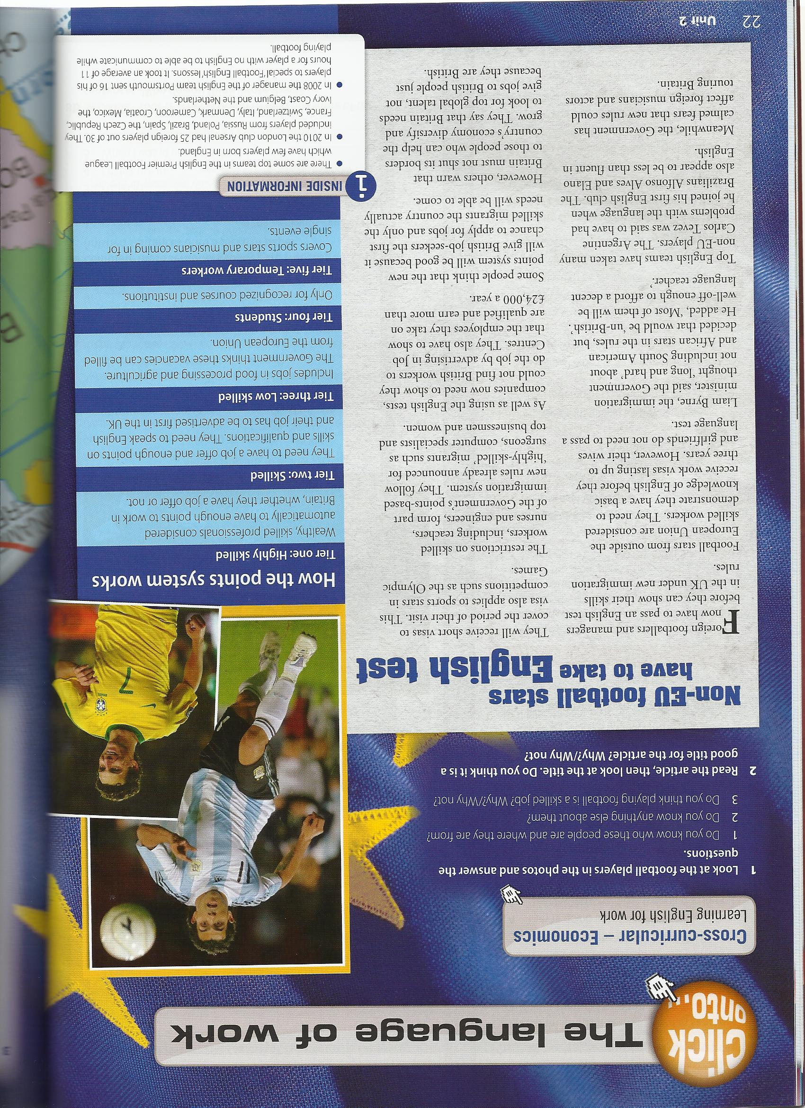
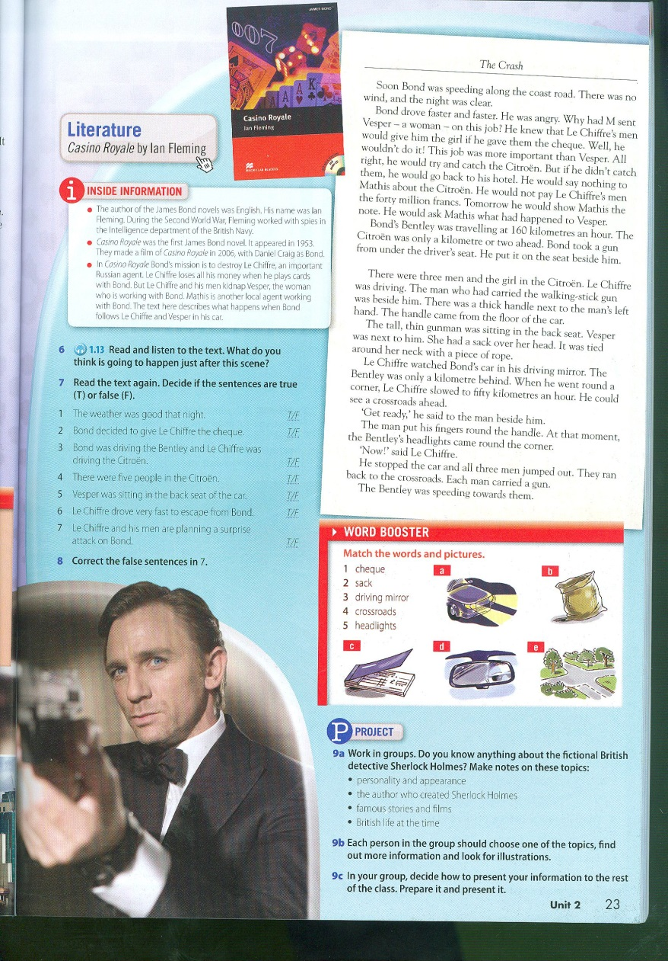
What’s happened to R-Patz and Kristen?
Why do footballers need English?
Who was Ian Flemming?

Slide 61
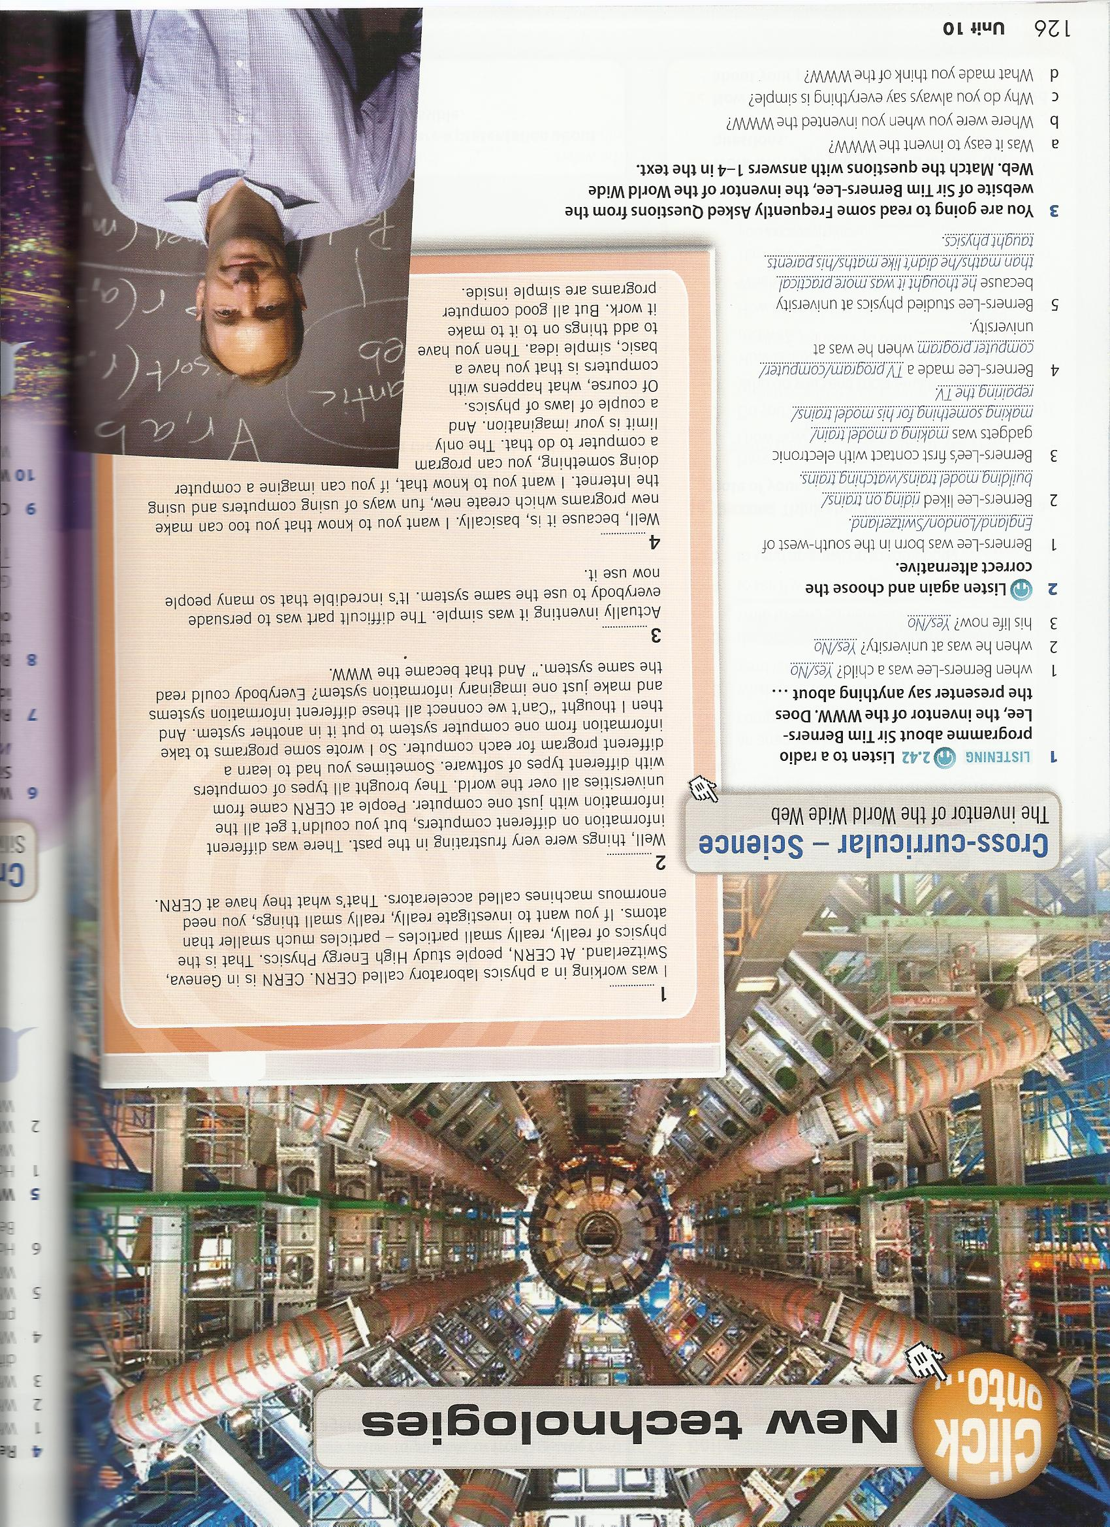

Slide 62
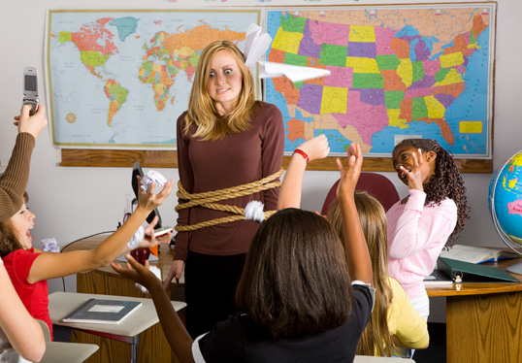
E. How to calm students down and get them concentrating

Slide 63
Column Dictations

Slide 64
Grammar I
MAKE | DO

Slide 65
Pronunciation – Word Stress
1) Oo | 2) oO | 3) oOo | 4) Ooo

Slide 66
Pronunciation – Word Stress
1) Oo | 2) oO | 3) oOo | 4) Ooo
bingo | upset | banana | iinteresting

Slide 67
Speaking - Opinions
I AGREE | I DISAGREE | IT DEPENDS

Slide 68
F. How to deal with mixed-ability

Slide 69
1) Online materials

Slide 70


Gateway Online

Slide 71

www.gateway-online.net
Accessing the site
Student’s Book
+ Webcode Pack
Code in back of book;
Access to one level only.
Teacher’s book
Code in back of book;
Access to all levels;
Can see both student and teacher material;
Access for 18 months, then renewal notice email sent.

Slide 72

What’s in store for students?
Interactive Activities
Each unit contains:
Video
Listening
Test Yourself
Writing
Plus!
Game
Class Audio
Interactive Wordlists
Students can:
build their own data-rich wordlists;
customise them;
print them;
sort them according to their frequency;
listen to native speaker recordings;
record themselves;
get practice exercises emailed to them on the words they want to revise.
Reader
Students get one Macmillan Reader with audio (if available), reading and listening worksheets, answer keys and a reading journal.
Markbook
Students’ own personal record of marks achieved in interactive activities. Can send marks to teacher and request teacher feedback on Writing activity.

Slide 73
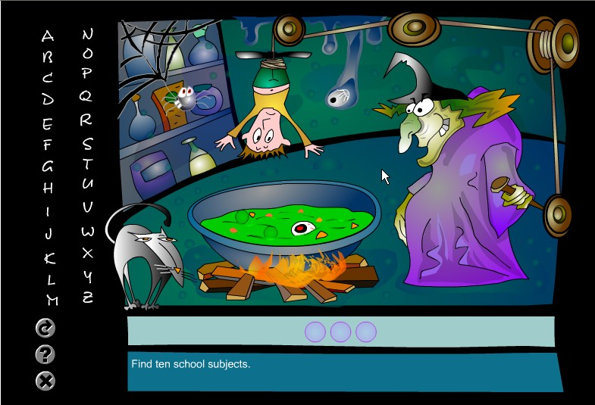

Slide 74
2) Extension work for stronger students

Slide 75
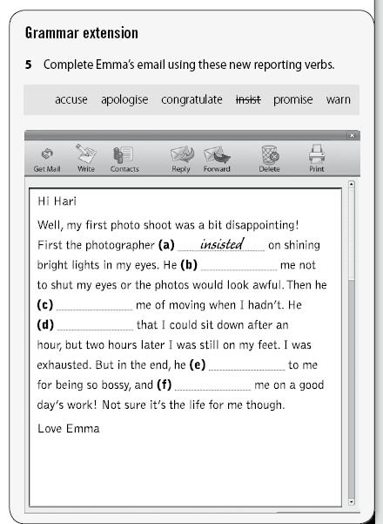
Treating
Mixed Ability

Slide 76
3) Open-ended tasks

Slide 77
Find a minimum of five things which are:
usually red.
usually round.
made of wood.

Slide 78
4) Activities for Fast-Finishers
(another thing to think about when planning)

Slide 79
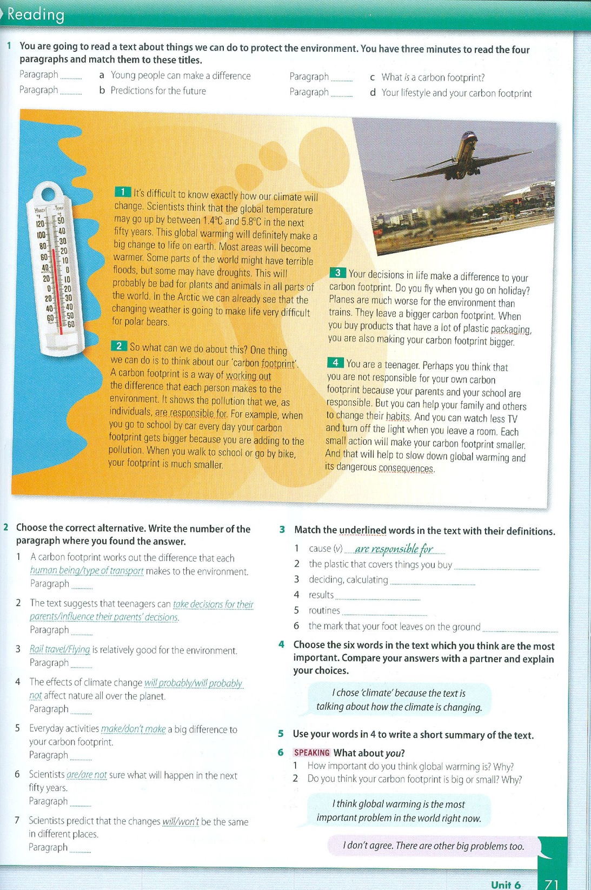
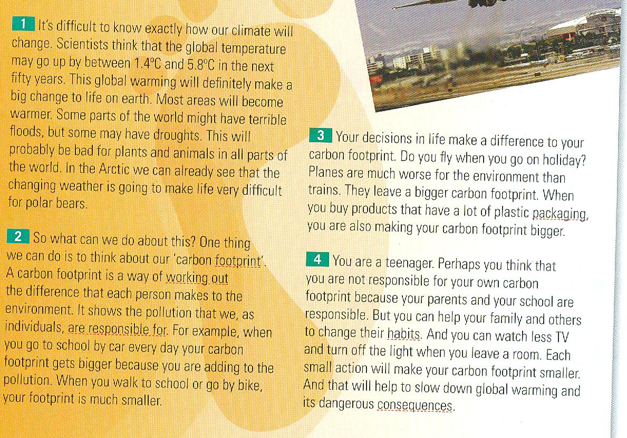

Slide 80
The A to Z of…
A → architect
B → builder
C → caretaker
D →
E →
…….

Slide 81
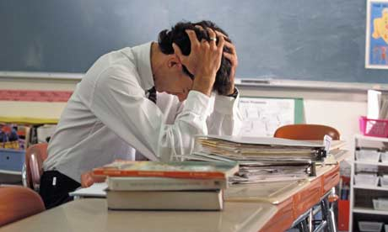

G. How to remain calm, sane and happy when classes are ‘difficult’

Slide 82
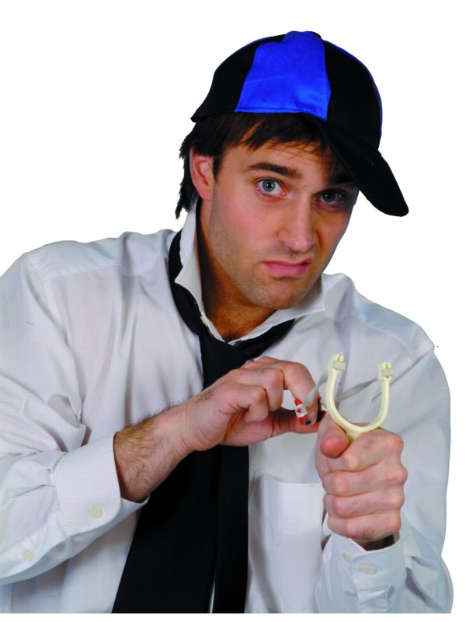
1) Remember that you were that age once.

Slide 83

2) Remember you are not alone!

Slide 84


Teacher Talk: diaries, letters
Blogs
Forums
Competitions
Lesson plan share

Slide 85

Participate in regular online webinars www.macmillanenglish.com/webinars
A range of EFL topics
Webinars from all over the world
Register for free
Archive of previous webinars

Slide 86
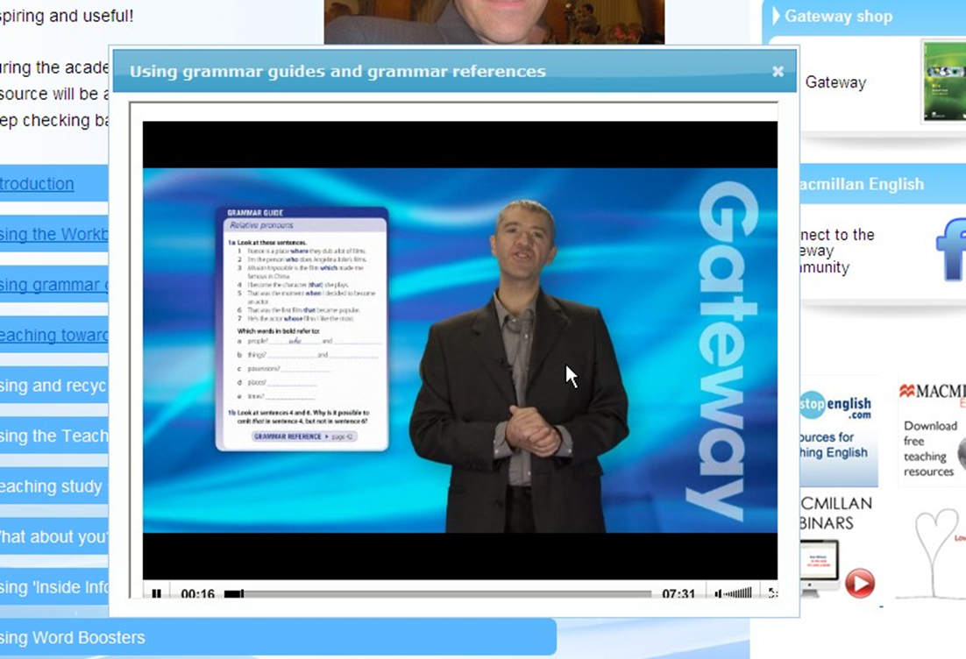

Slide 88



www.gateway-online.net www.facebook.com/macmillangateway www.iptrussia.ru

Slide 89
Other final ideas
Spelling backwards

Slide 90
Just say ‘yes’!

Slide 91
Grammar structure bingo
Present simple
Present continuous
Past simple
Past continuous
Present perfect simple
Present perfect continuous
Past perfect simple
Past perfect continuous
Used to
Future simple
Future continuous
Future perfect
Comparative
Superlative
Reported speech

Slide 92
Grammar structure bingo
Present simple
Present continuous
Past simple
Past continuous
Present perfect simple
Present perfect continuous
Past perfect simple
Past perfect continuous
Used to
Future simple
Future continuous
Future perfect
Comparative
Superlative
Reported speech
I am playing bingo. | I was shopping yesterday. | I have been revising.
I used to like fish. | I will be away next week. | I am taller than you.
I am the best at English. | I will have finished by 8pm. | I will be playing golf on Saturday.
I used to go to playschool. | I have finished. | I had left by the time they arrived.

Slide 93
Grammar structure bingo
Present simple
Present continuous
Past simple
Past continuous
Present perfect simple
Present perfect continuous
Past perfect simple
Past perfect continuous
Used to
Future simple
Future continuous
Future perfect
Comparative
Superlative
Reported speech
I am playing bingo. | I was shopping yesterday. | I have been revising.
I used to like fish. | I will be away next week. | I am taller than you.
I am the best at English. | I will have finished by 8pm. | I will be playing golf on Saturday.
I used to go to playschool. | I have finished. | I had left by the time they arrived.

Slide 94
First and last lines…
A: ‘Hello, how are you?’
B: ‘No.’
A: ……………
‘Liam was having a terrible day….’
‘…….and that’s how I got arrested.’

Slide 95
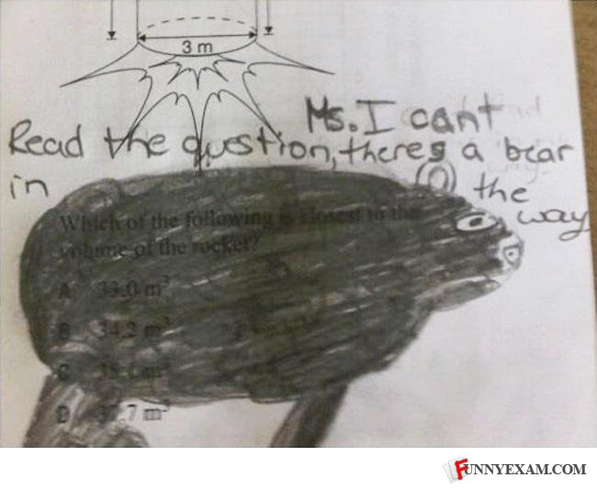
Remember not to take things so seriously…….

Slide 96
