Slide 1

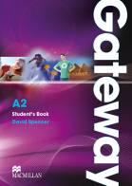

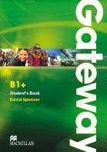
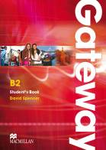



Gateway to
Exam Success
Liam Tyler

Slide 2
Gateway to Exam success
Exams: general considerations
Key rules for exam success
Working with specific tasks

Slide 3


Exams, exams, exams.....

Slide 4
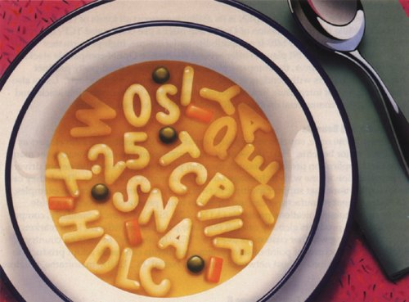
English Exams: An Alphabet Soup

Slide 5
International English Language Testing System
Key English Language Test
Preliminary English Test
The First Certificate in English
The Certificate in Advanced English
Test of English as a Foreign Language
IELTS
KET
PET
FCE
CAE
TOEFL
+ Local state exams (ГЕА, ЕГЭ)

Slide 6

Good news: there’s a skills overlap

Slide 7
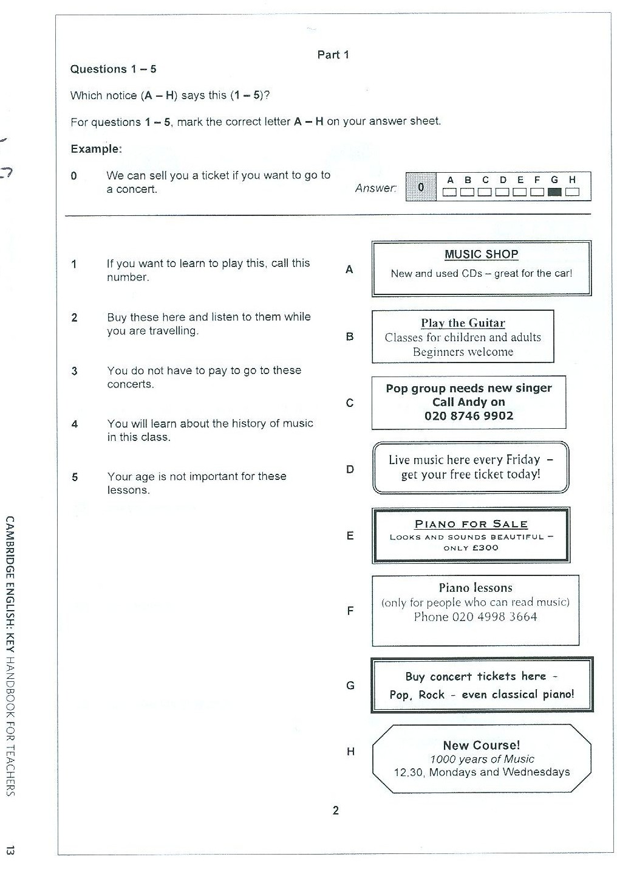
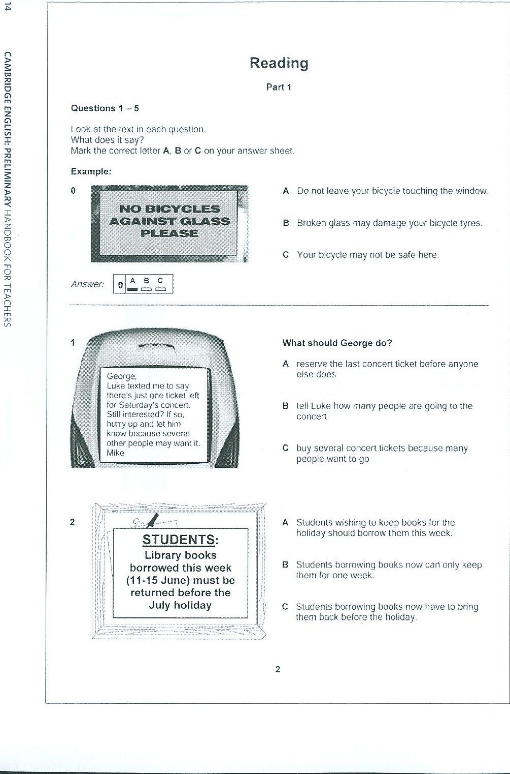

Slide 8

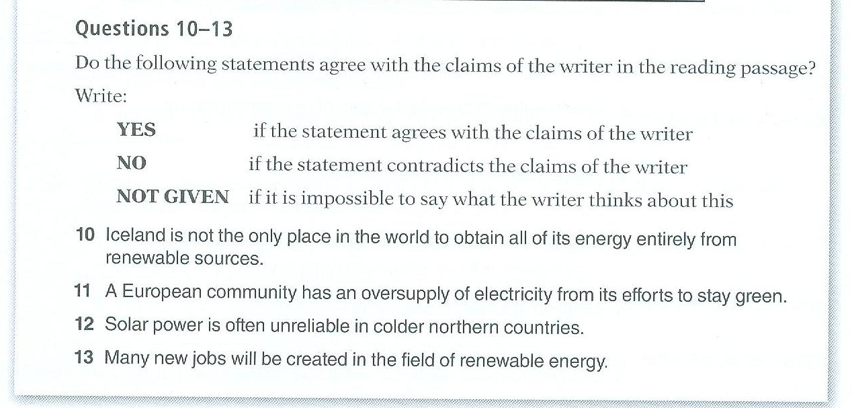
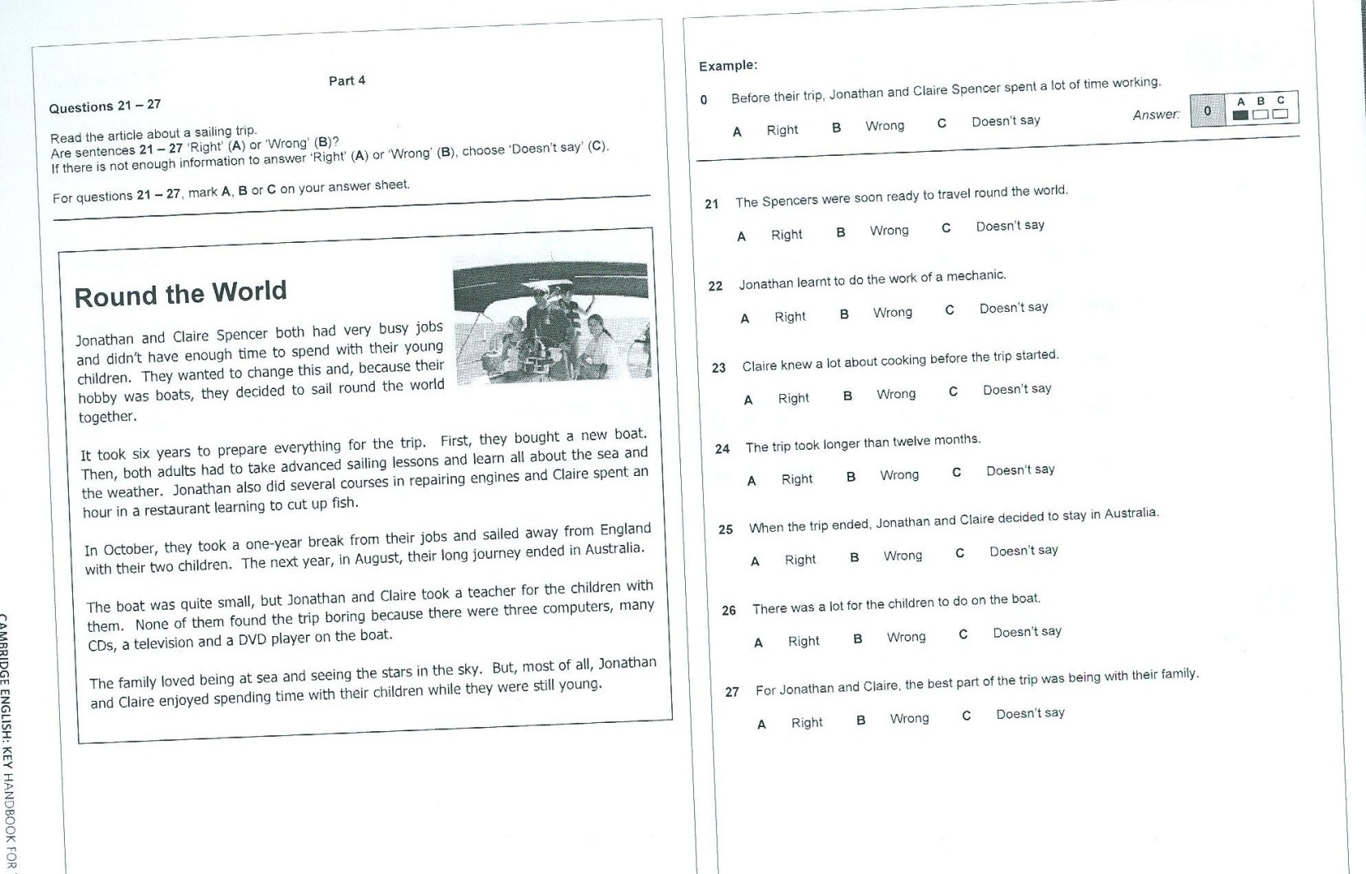

Slide 9
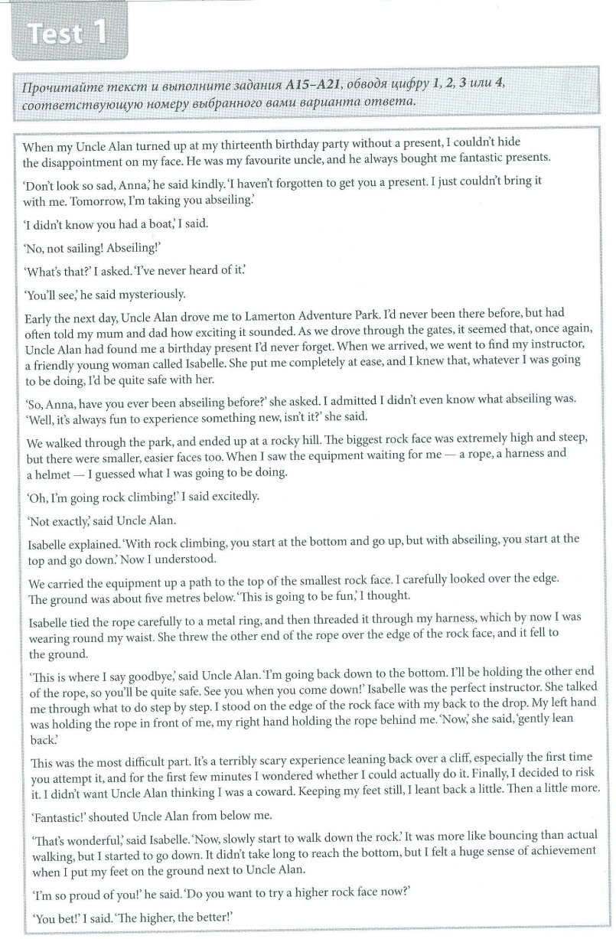
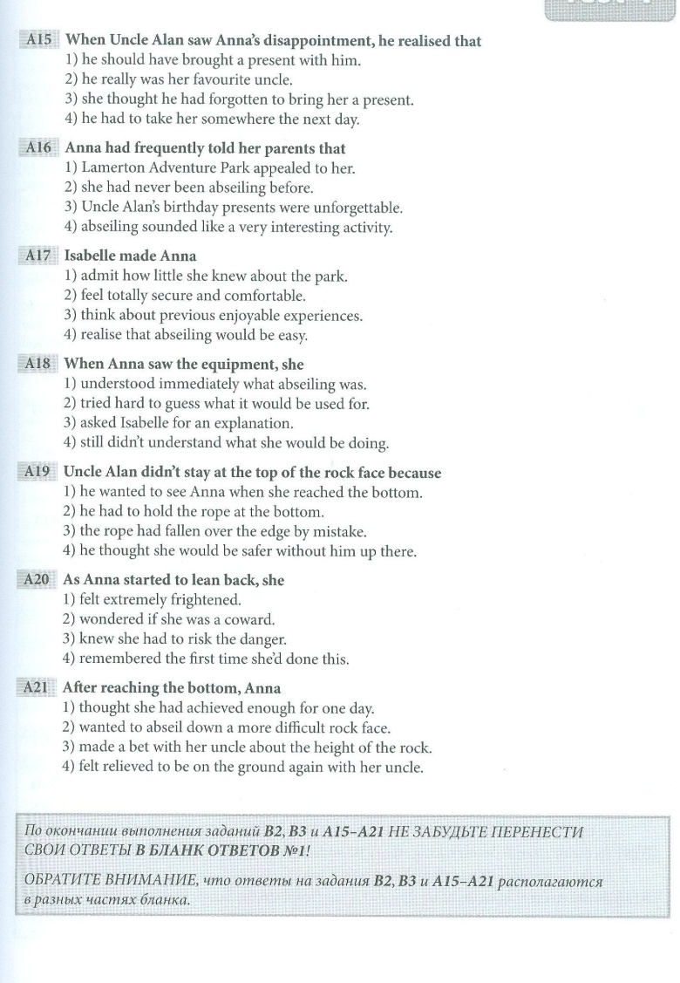
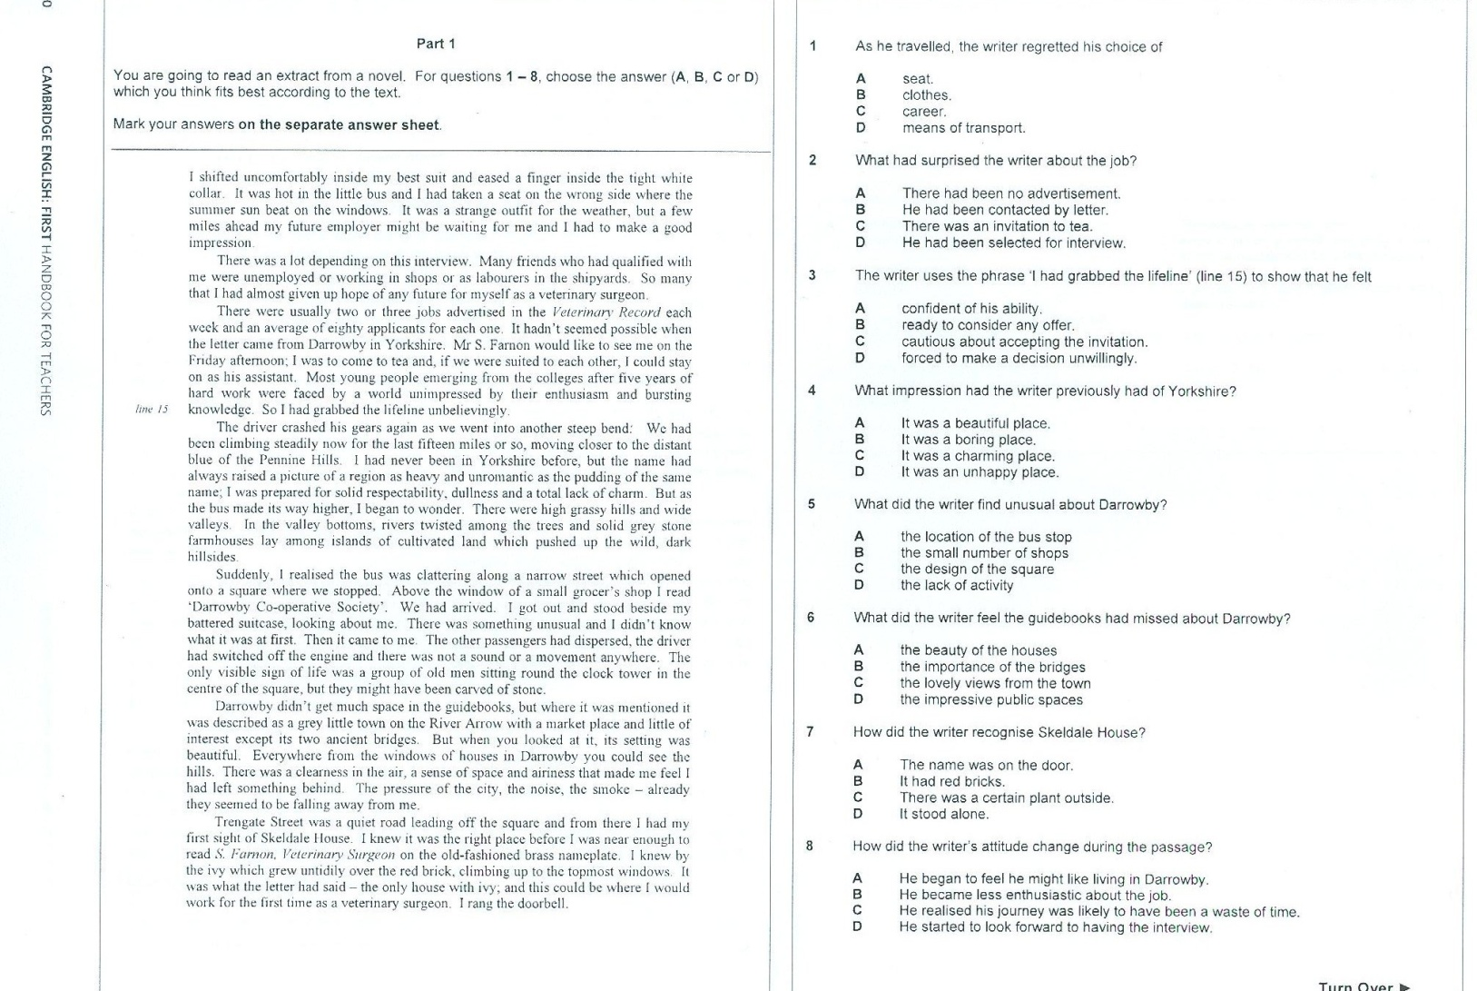

Slide 10

Some rules of success for exam preparation

Slide 11


Slide 12
Students......
need to know the t____
need to be familiar with skills such as reading for g____, sc_______, g_______ meaning from context
need to know useful exam t______ and s_______ for different tasks
need to build c_______
need to be familiar with s______ answers
need to develop i_______ study skills
need sufficient p____ with the test and authentic f_______ on results/progress

Slide 13
Students......
need to know the test
need to be familiar with skills such as reading for g____, sc_______, g_______ meaning from context
need to know useful exam t______ and s_______ for different tasks
need to build c_______
need to be familiar with s______ answers
need to develop i_______ study skills
need sufficient p____ with the test and authentic f_______ on results/progress

Slide 14
Students......
need to know the test
need to be familiar with skills such as reading for gist, scanning, guessing meaning from context
need to know useful exam t______ and s_______ for different tasks
need to build c_______
need to be familiar with s______ answers
need to develop i_______ study skills
need sufficient p____ with the test and authentic f_______ on results/progress

Slide 15
Students......
need to know the test
need to be familiar with skills such as reading for gist, scanning, guessing meaning from context
need to know useful exam techniques and strategies for different tasks
need to build c_______
need to be familiar with s______ answers
need to develop i_______ study skills
need sufficient p____ with the test and authentic f_______ on results/progress

Slide 16
Students......
need to know the test
need to be familiar with skills such as reading for gist, scanning, guessing meaning from context
need to know useful exam techniques and strategies for different tasks
need to build confidence
need to be familiar with s______ answers
need to develop i_______ study skills
need sufficient p____ with the test and authentic f_______ on results/progress

Slide 17
Students......
need to know the test
need to be familiar with skills such as reading for gist, scanning, guessing meaning from context
need to know useful exam techniques and strategies for different tasks
need to build confidence
need to be familiar with sample answers
need to develop i_______ study skills
need sufficient p____ with the test and authentic f_______ on results/progress

Slide 18
Students......
need to know the test
need to be familiar with skills such as reading for gist, scanning, guessing meaning from context
need to know useful exam techniques and strategies for different tasks
need to build confidence
need to be familiar with sample answers
need to develop independent study skills
need sufficient p____ with the test and authentic f_______ on results/progress

Slide 19
Students......
need to know the test
need to be familiar with skills such as reading for gist, scanning, guessing meaning from context
need to know useful exam techniques and strategies for different tasks
need to build confidence
need to be familiar with sample answers
need to develop independent study skills
need sufficient practice with the test and authentic feedback on results/progress

Slide 20

1. Familiarity with the test: task types and exam skills
“Familiarity with the format and the task type almost always results in a higher score. The test does not only test a student’s ability, it also tests their ability to do the test.”
Adrian Tennant
Notes:
Replace with Gateway stuff here!!!

Slide 21
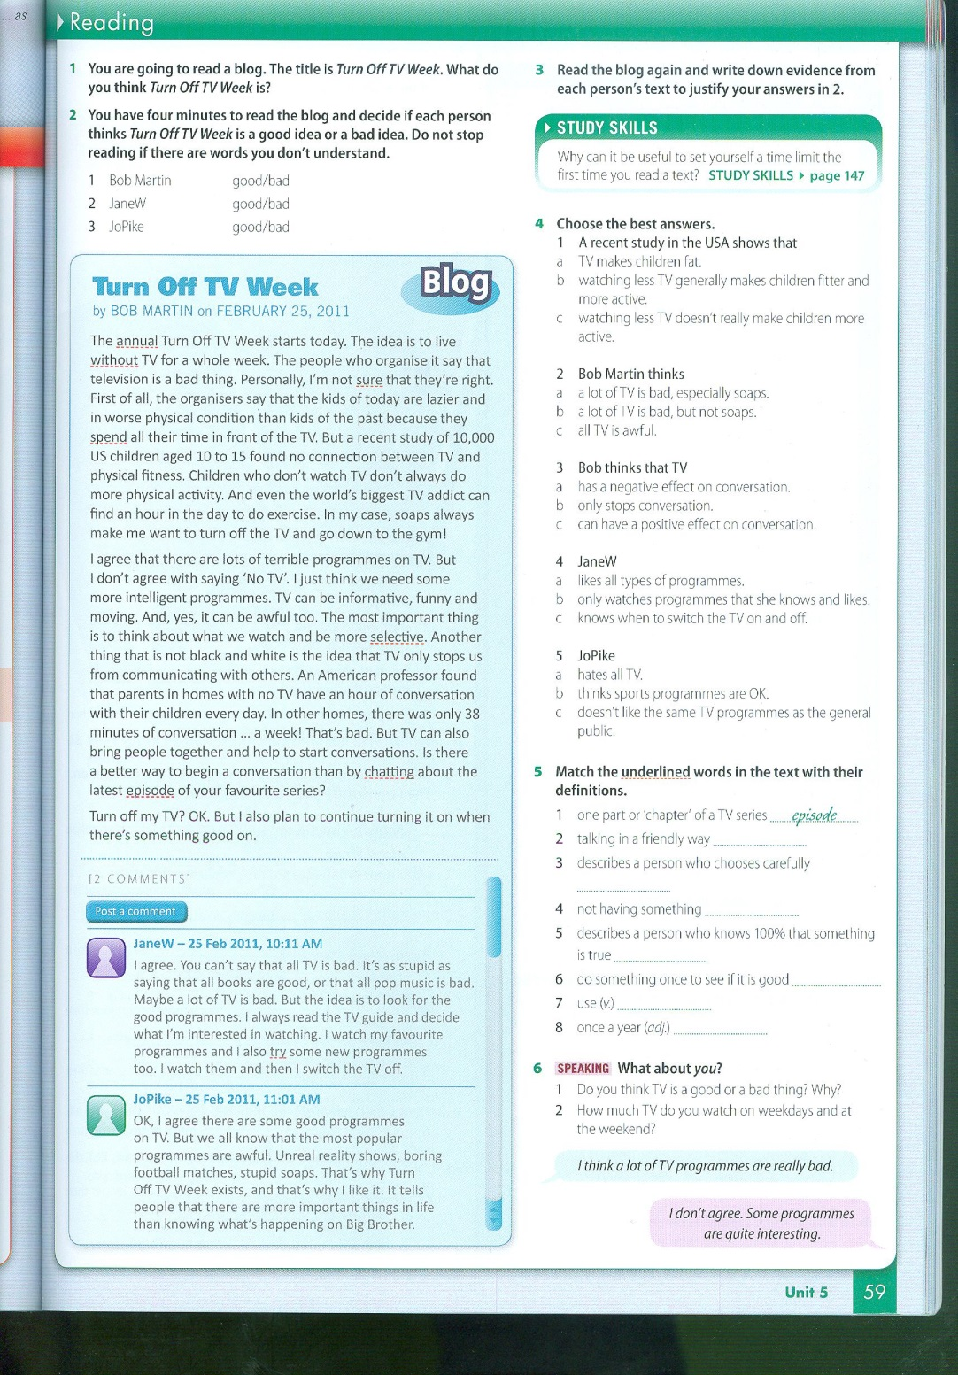

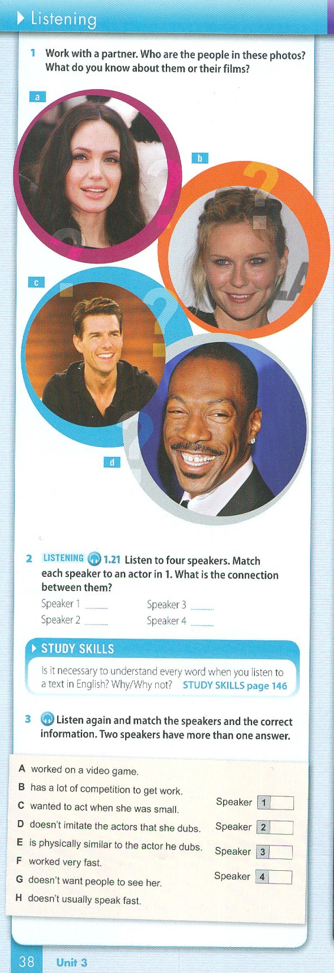
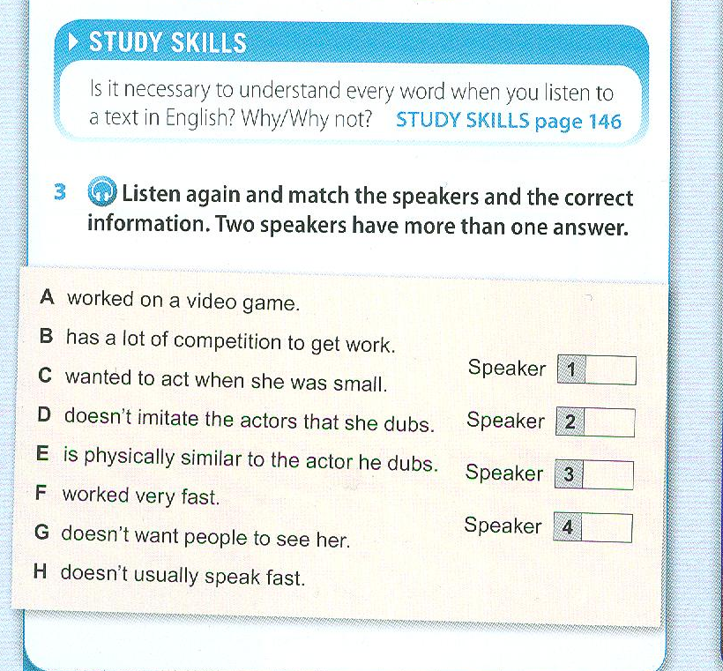

Slide 22
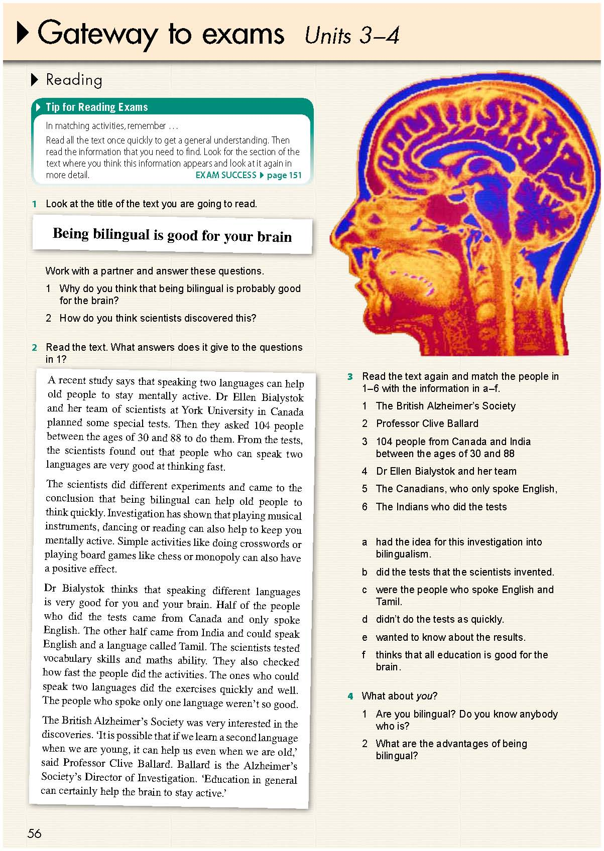
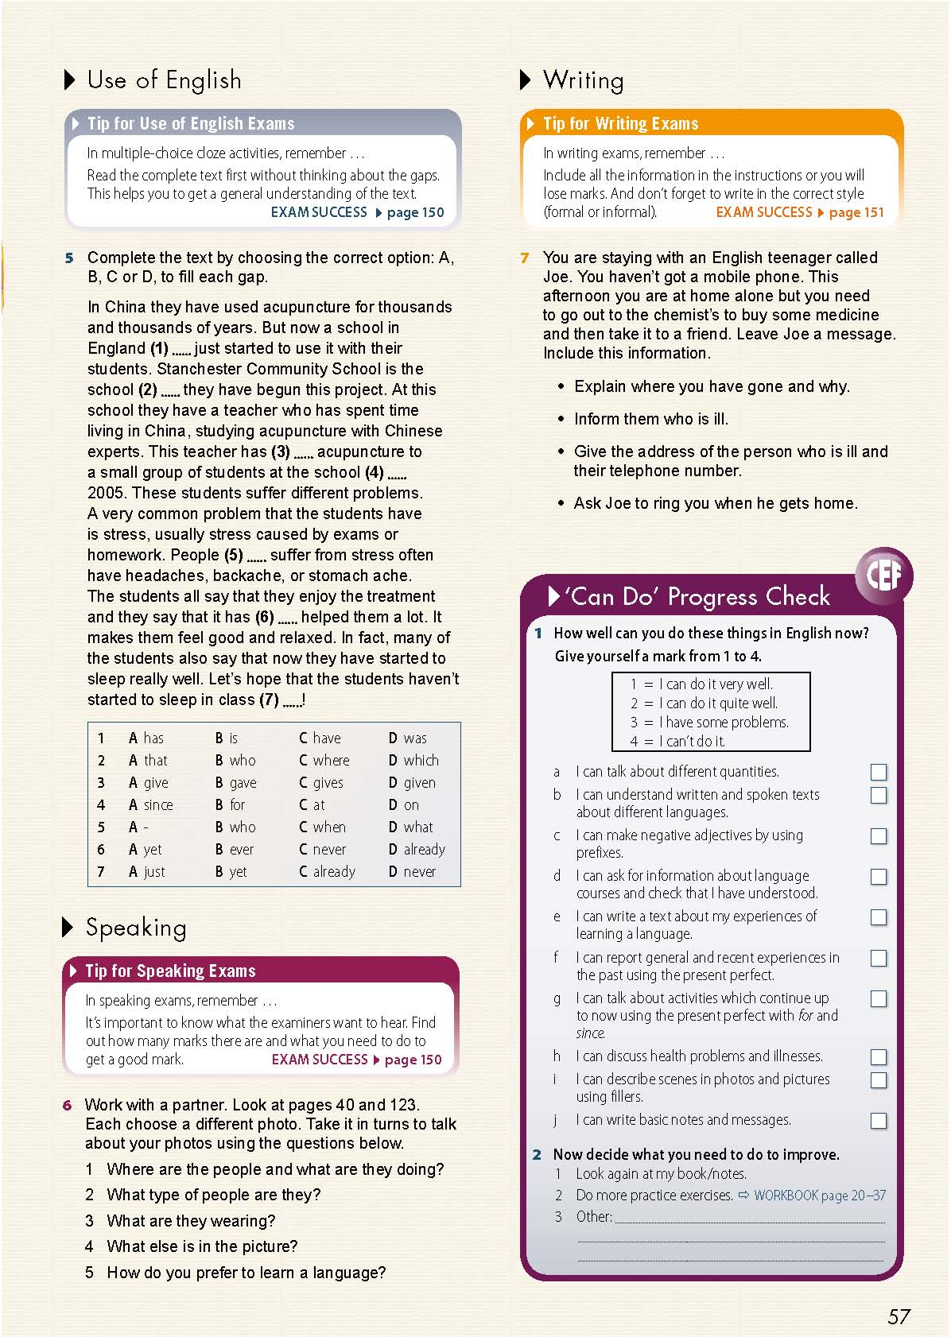

Slide 23
Not only what to do, but also how to do it!

Slide 24

Which skills are being trained here?

Slide 25
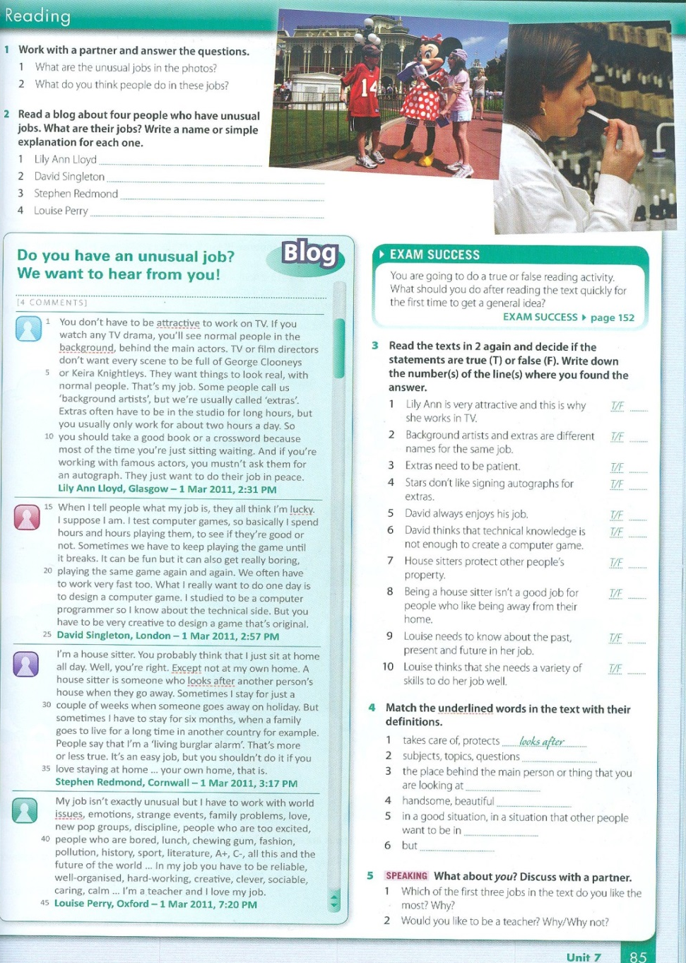
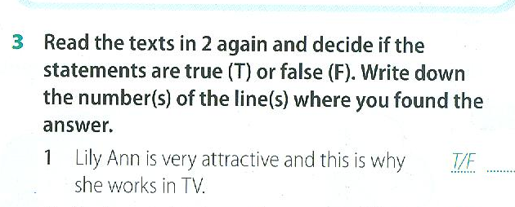
What skill is being trained here?

Slide 26
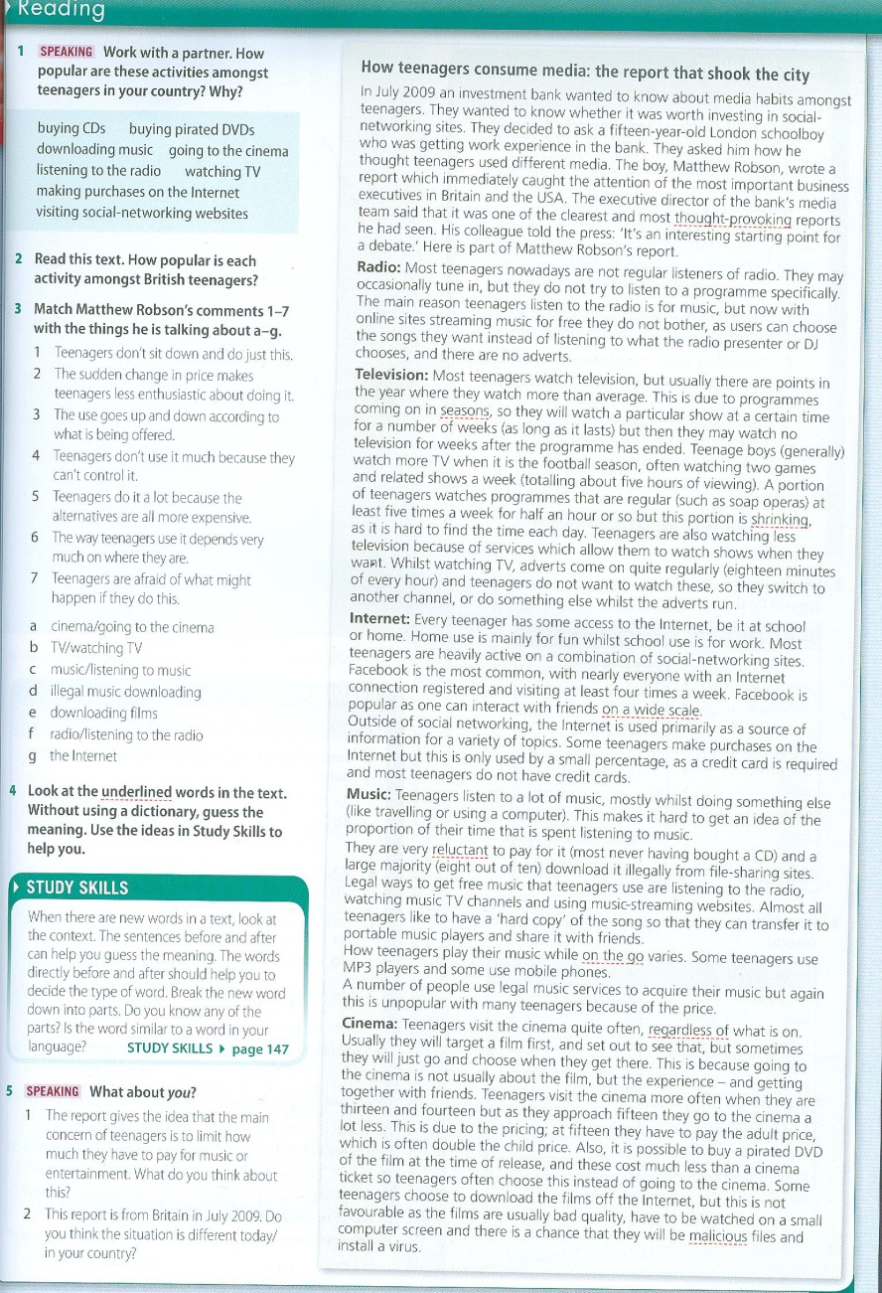

Which skill is being trained here?

Slide 27
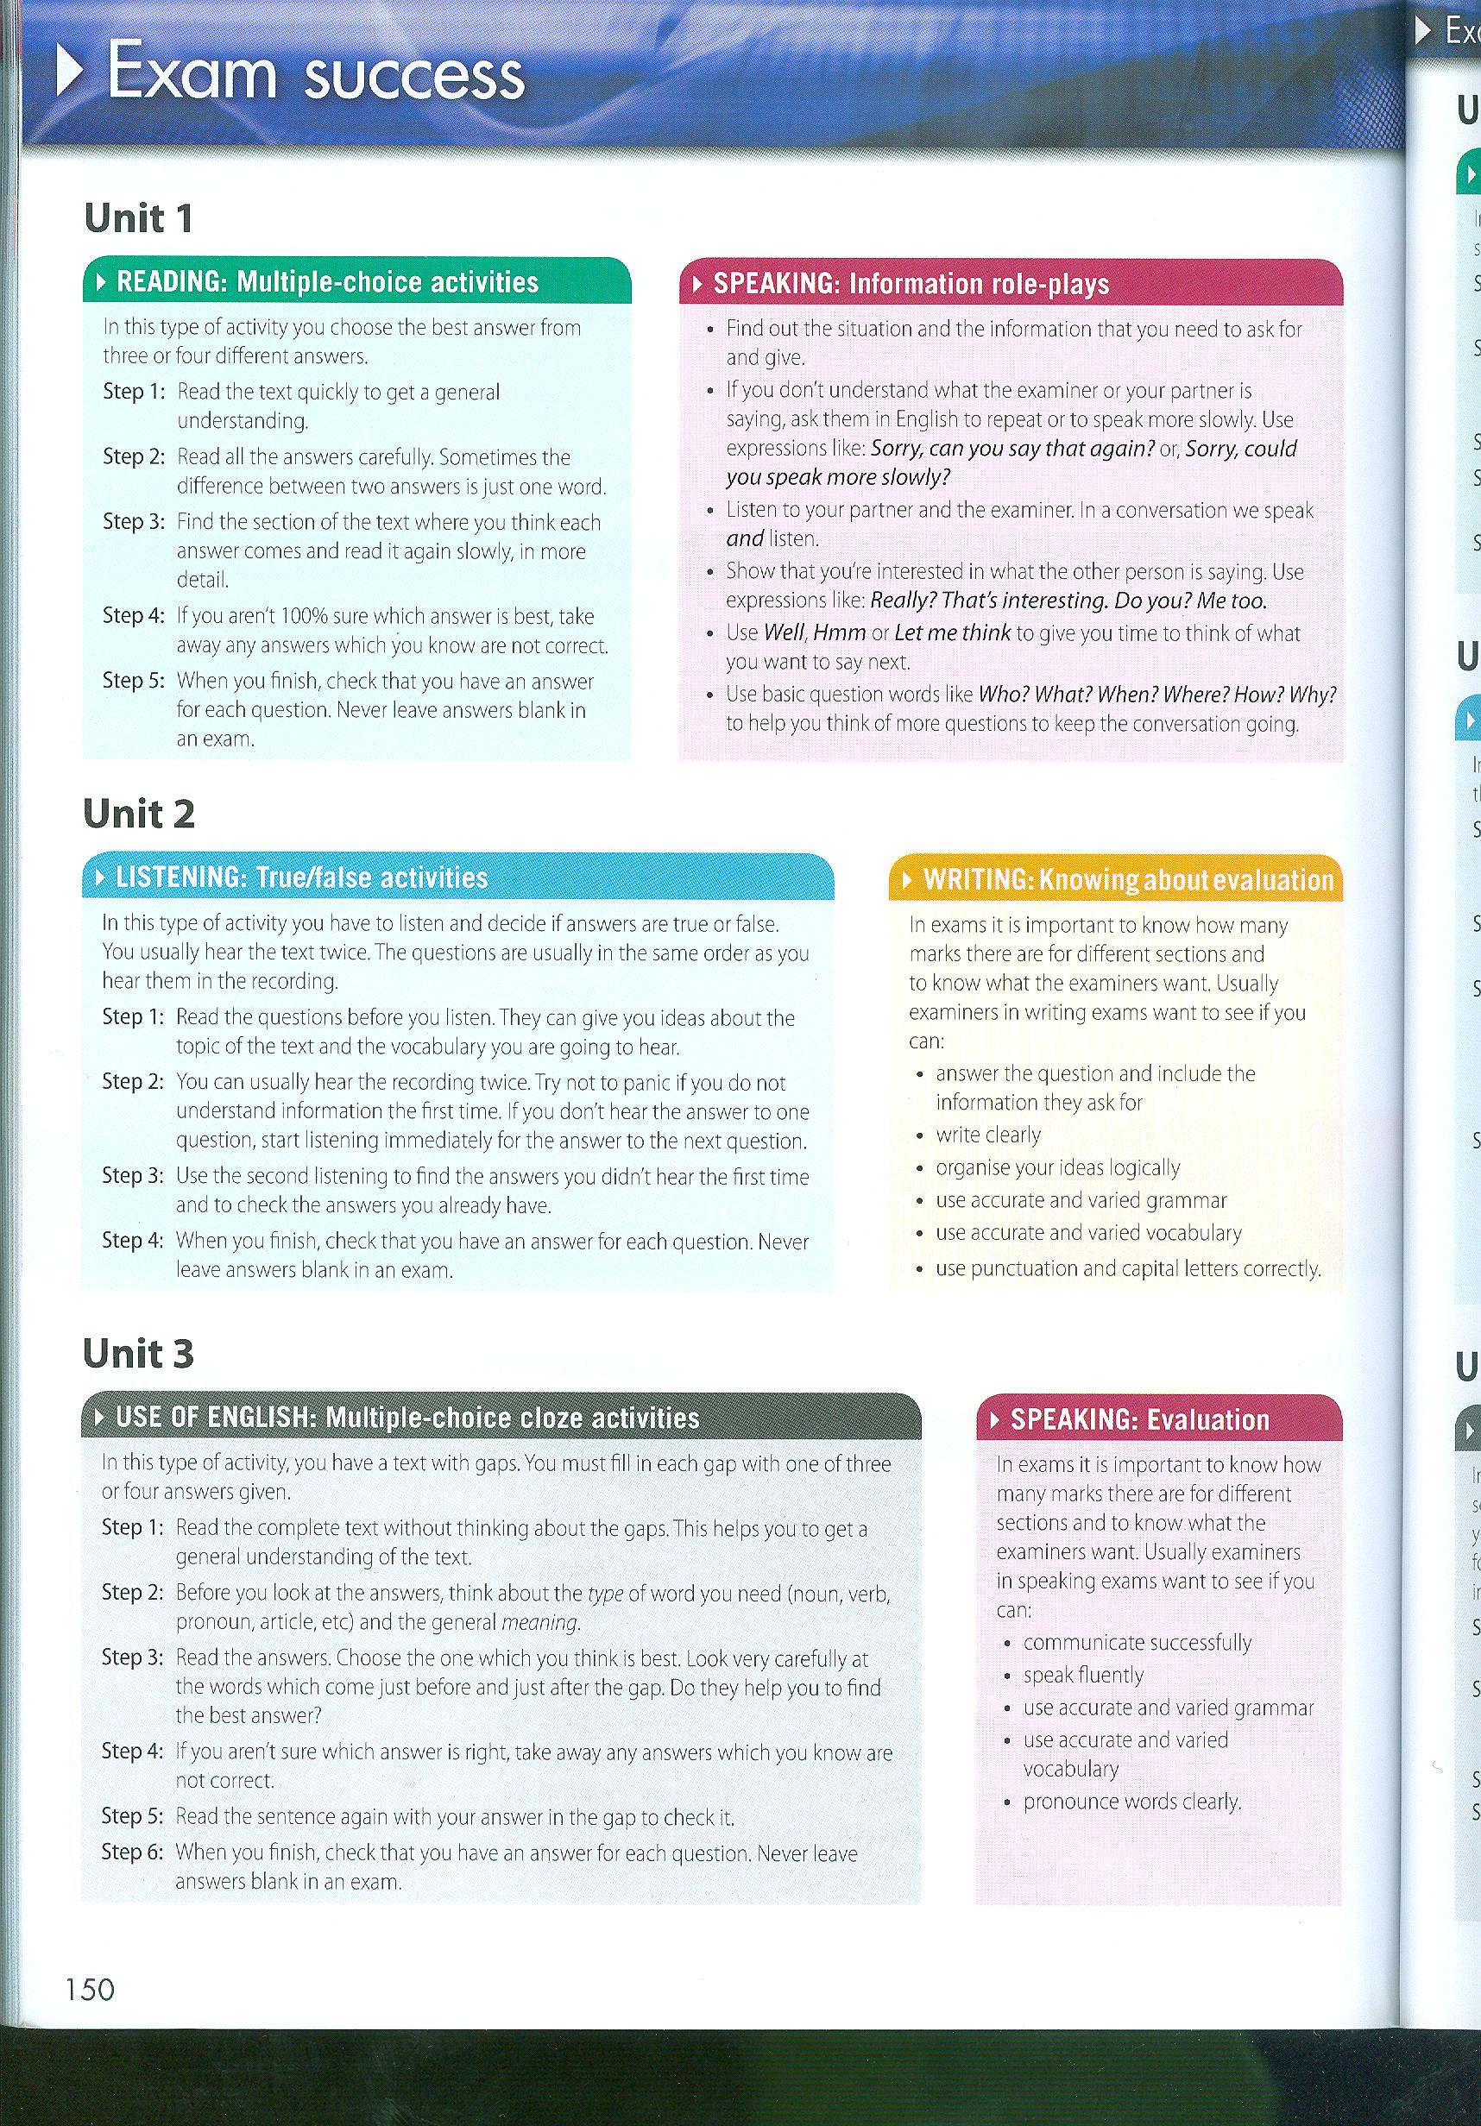
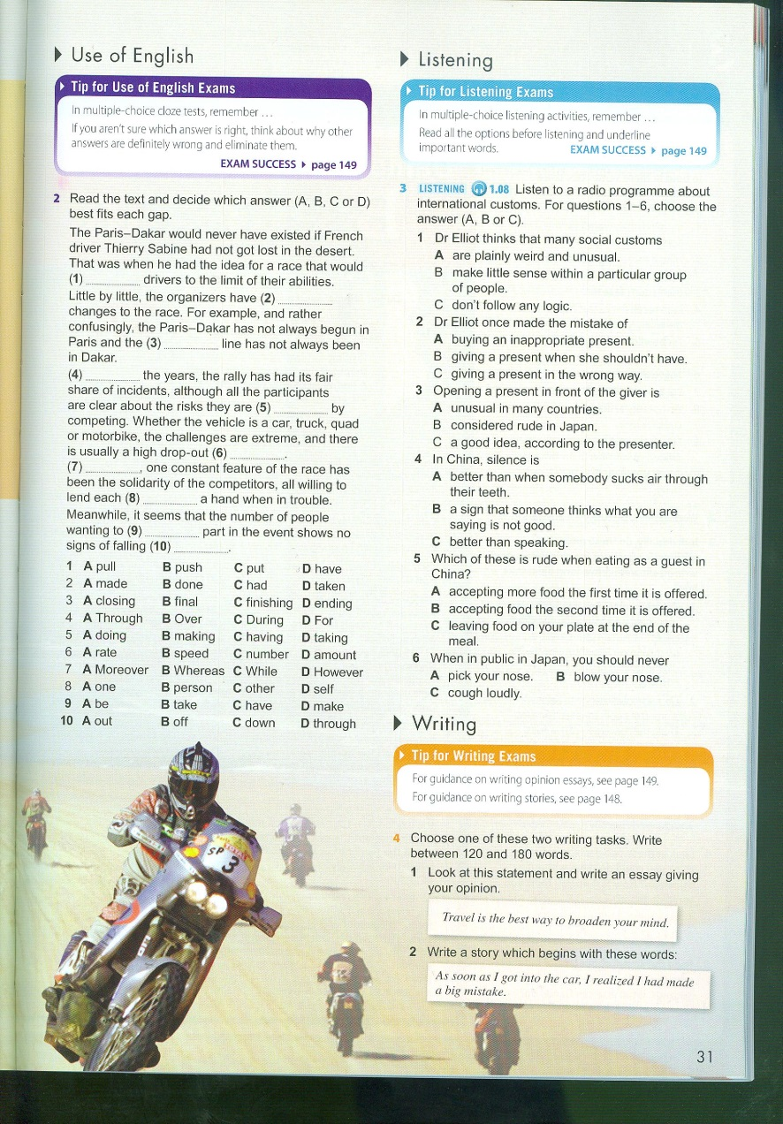

Slide 28
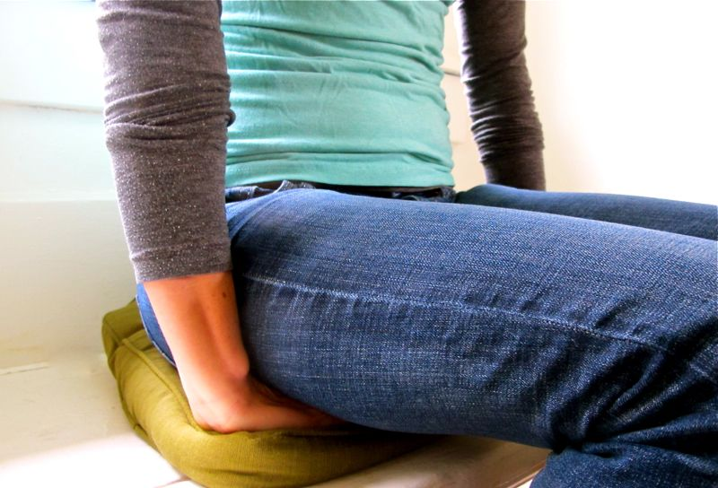

Slide 30
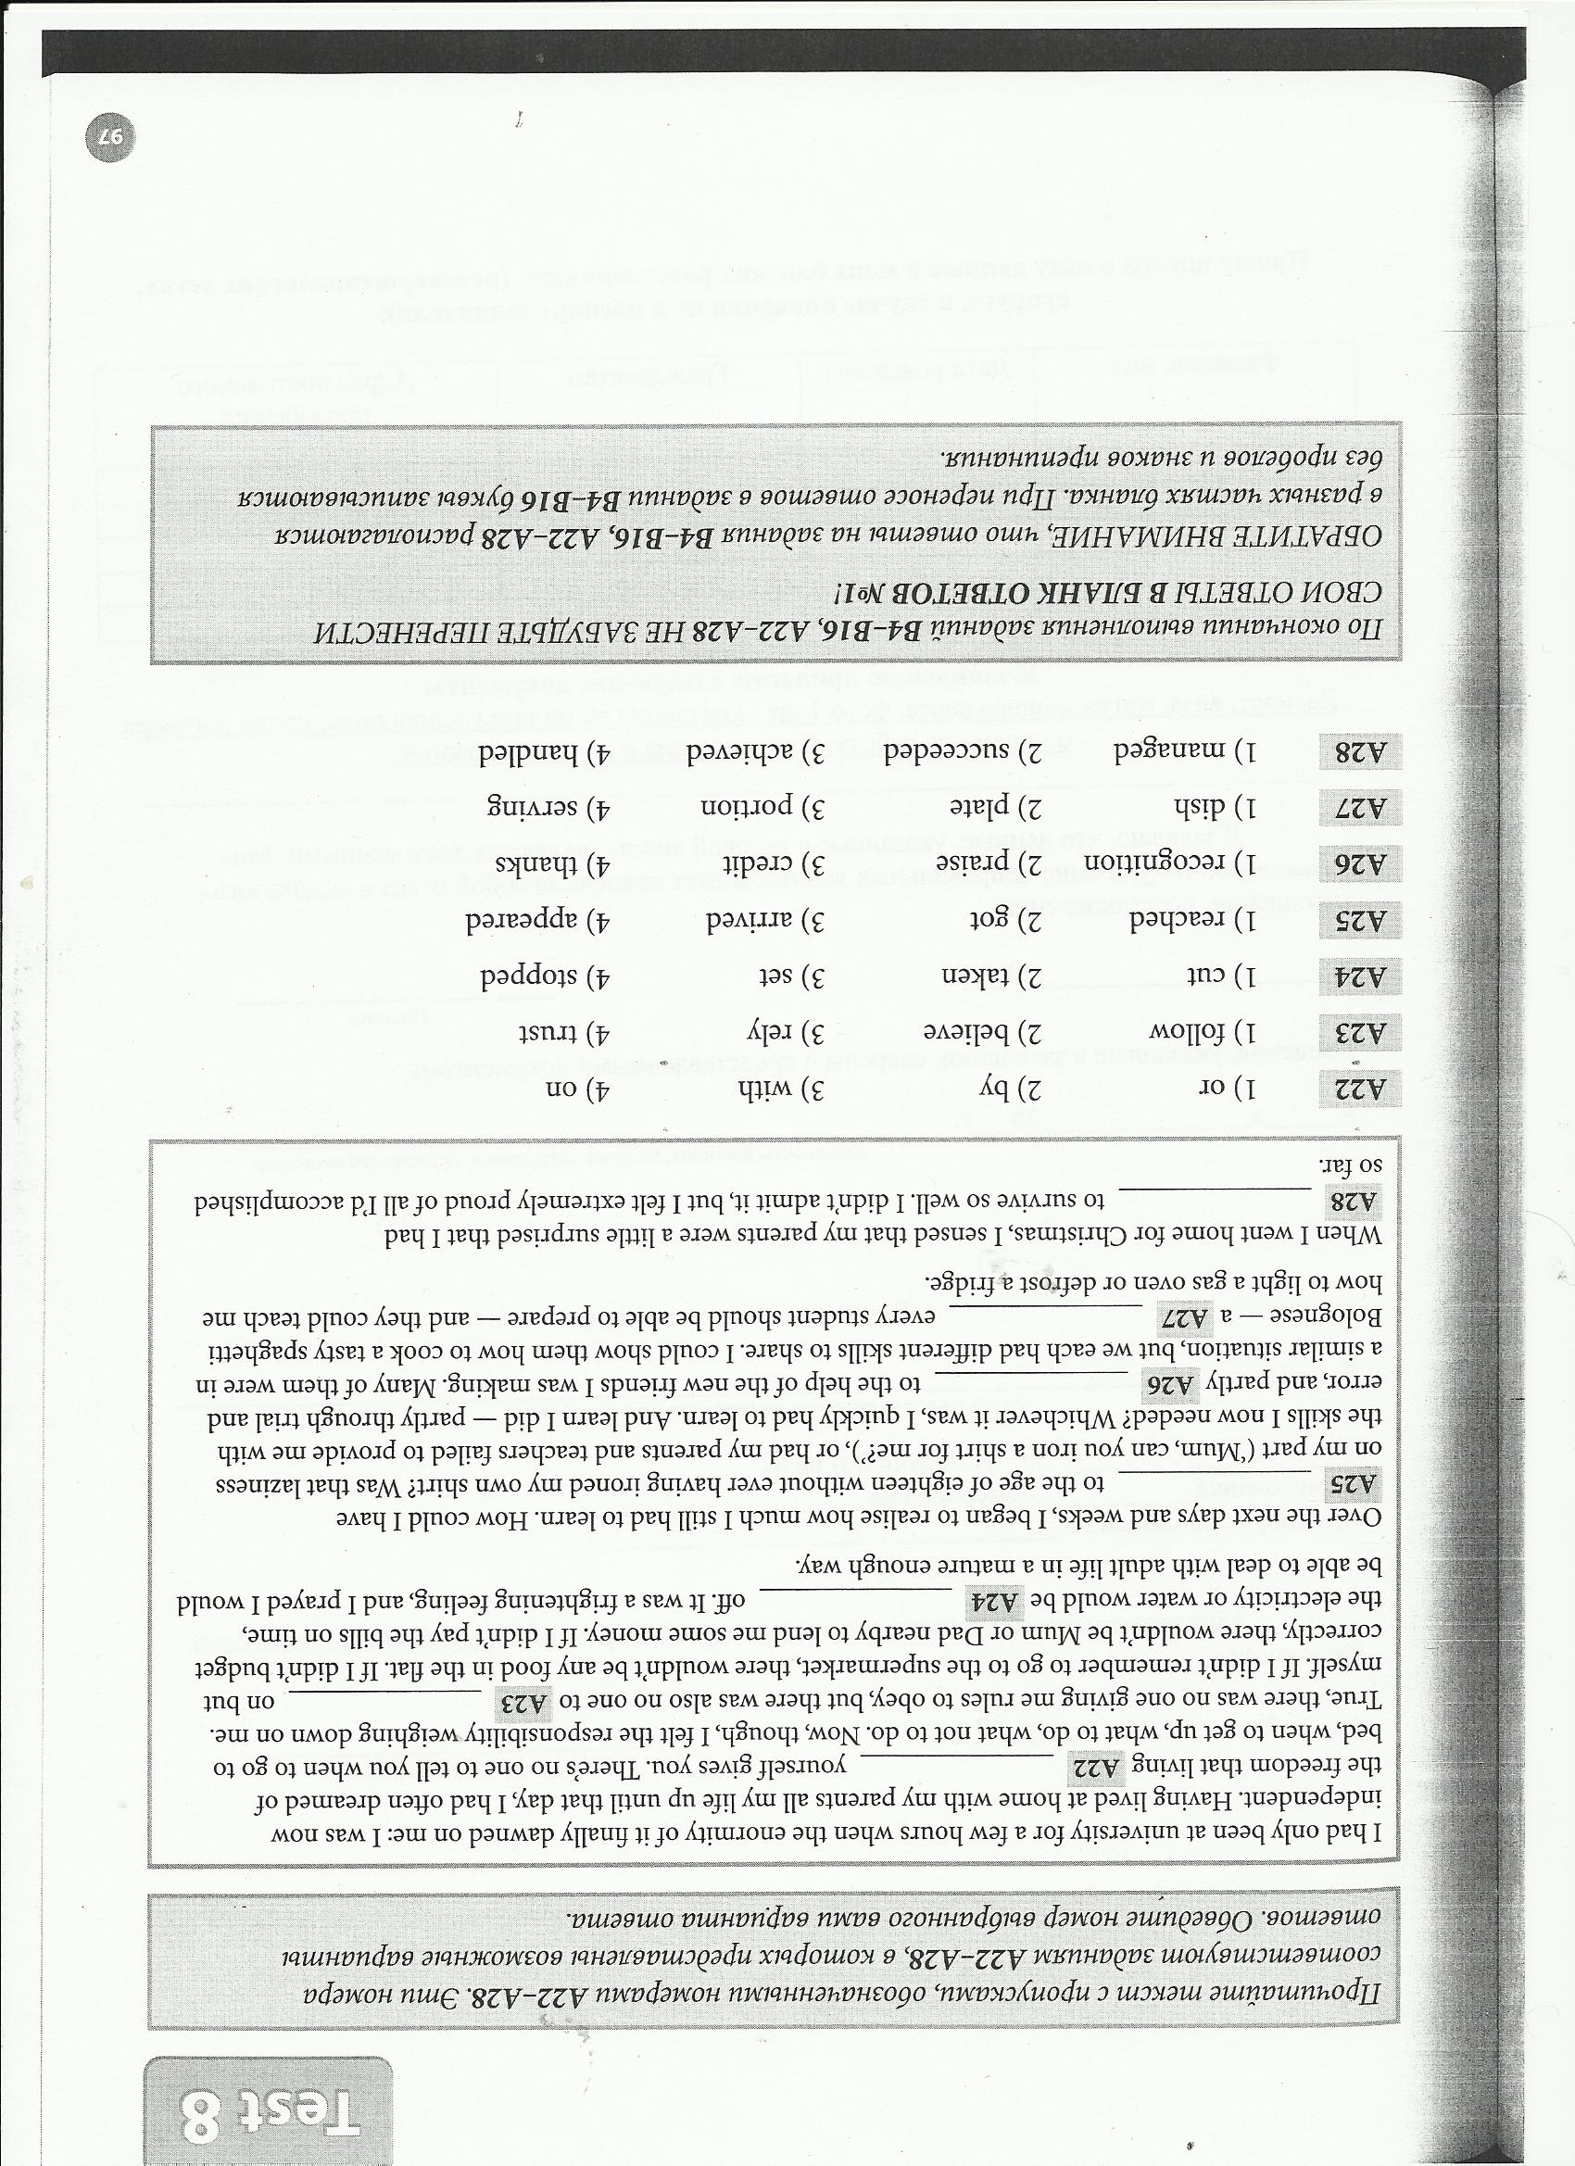
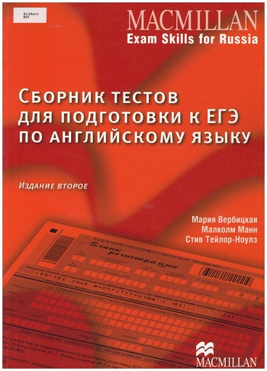

Slide 31

2. Build confidence

Slide 32
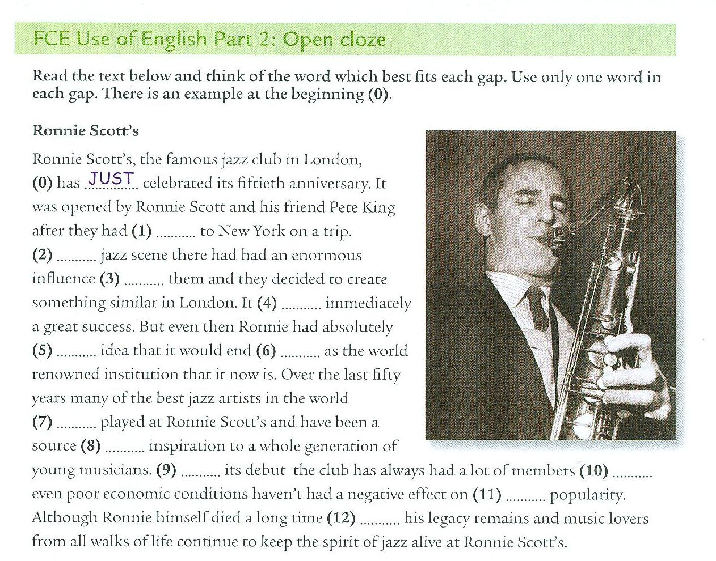
Give them a hand to build confidence
1. _ _ _ _
2. _ _ _
3. _ _
4. _ _ _
1. b _ _ _
2. T _ _
3. o _
4. w _ _
1. _ e e _
2. _ h _
3. _ n
4. _ a _
the
was
been
on

Slide 33
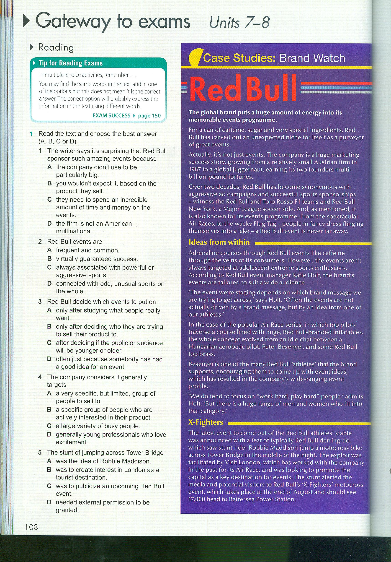

Slide 36
3. Use the advice, skills and functions boxes in
Gateway

Slide 38

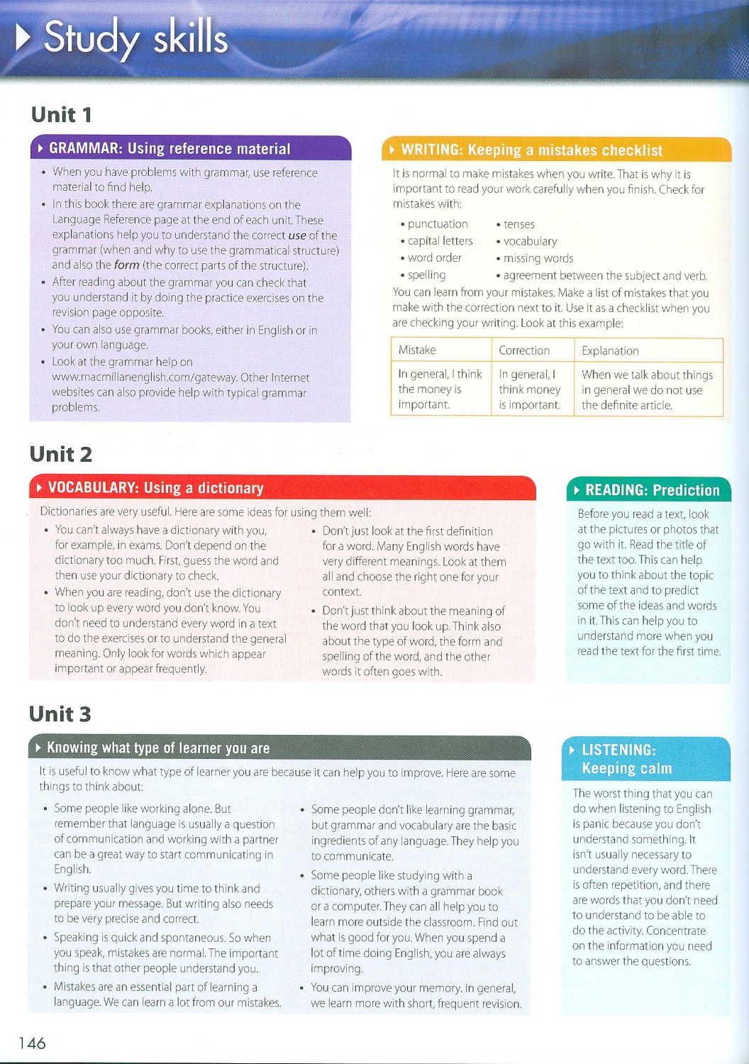

Slide 39
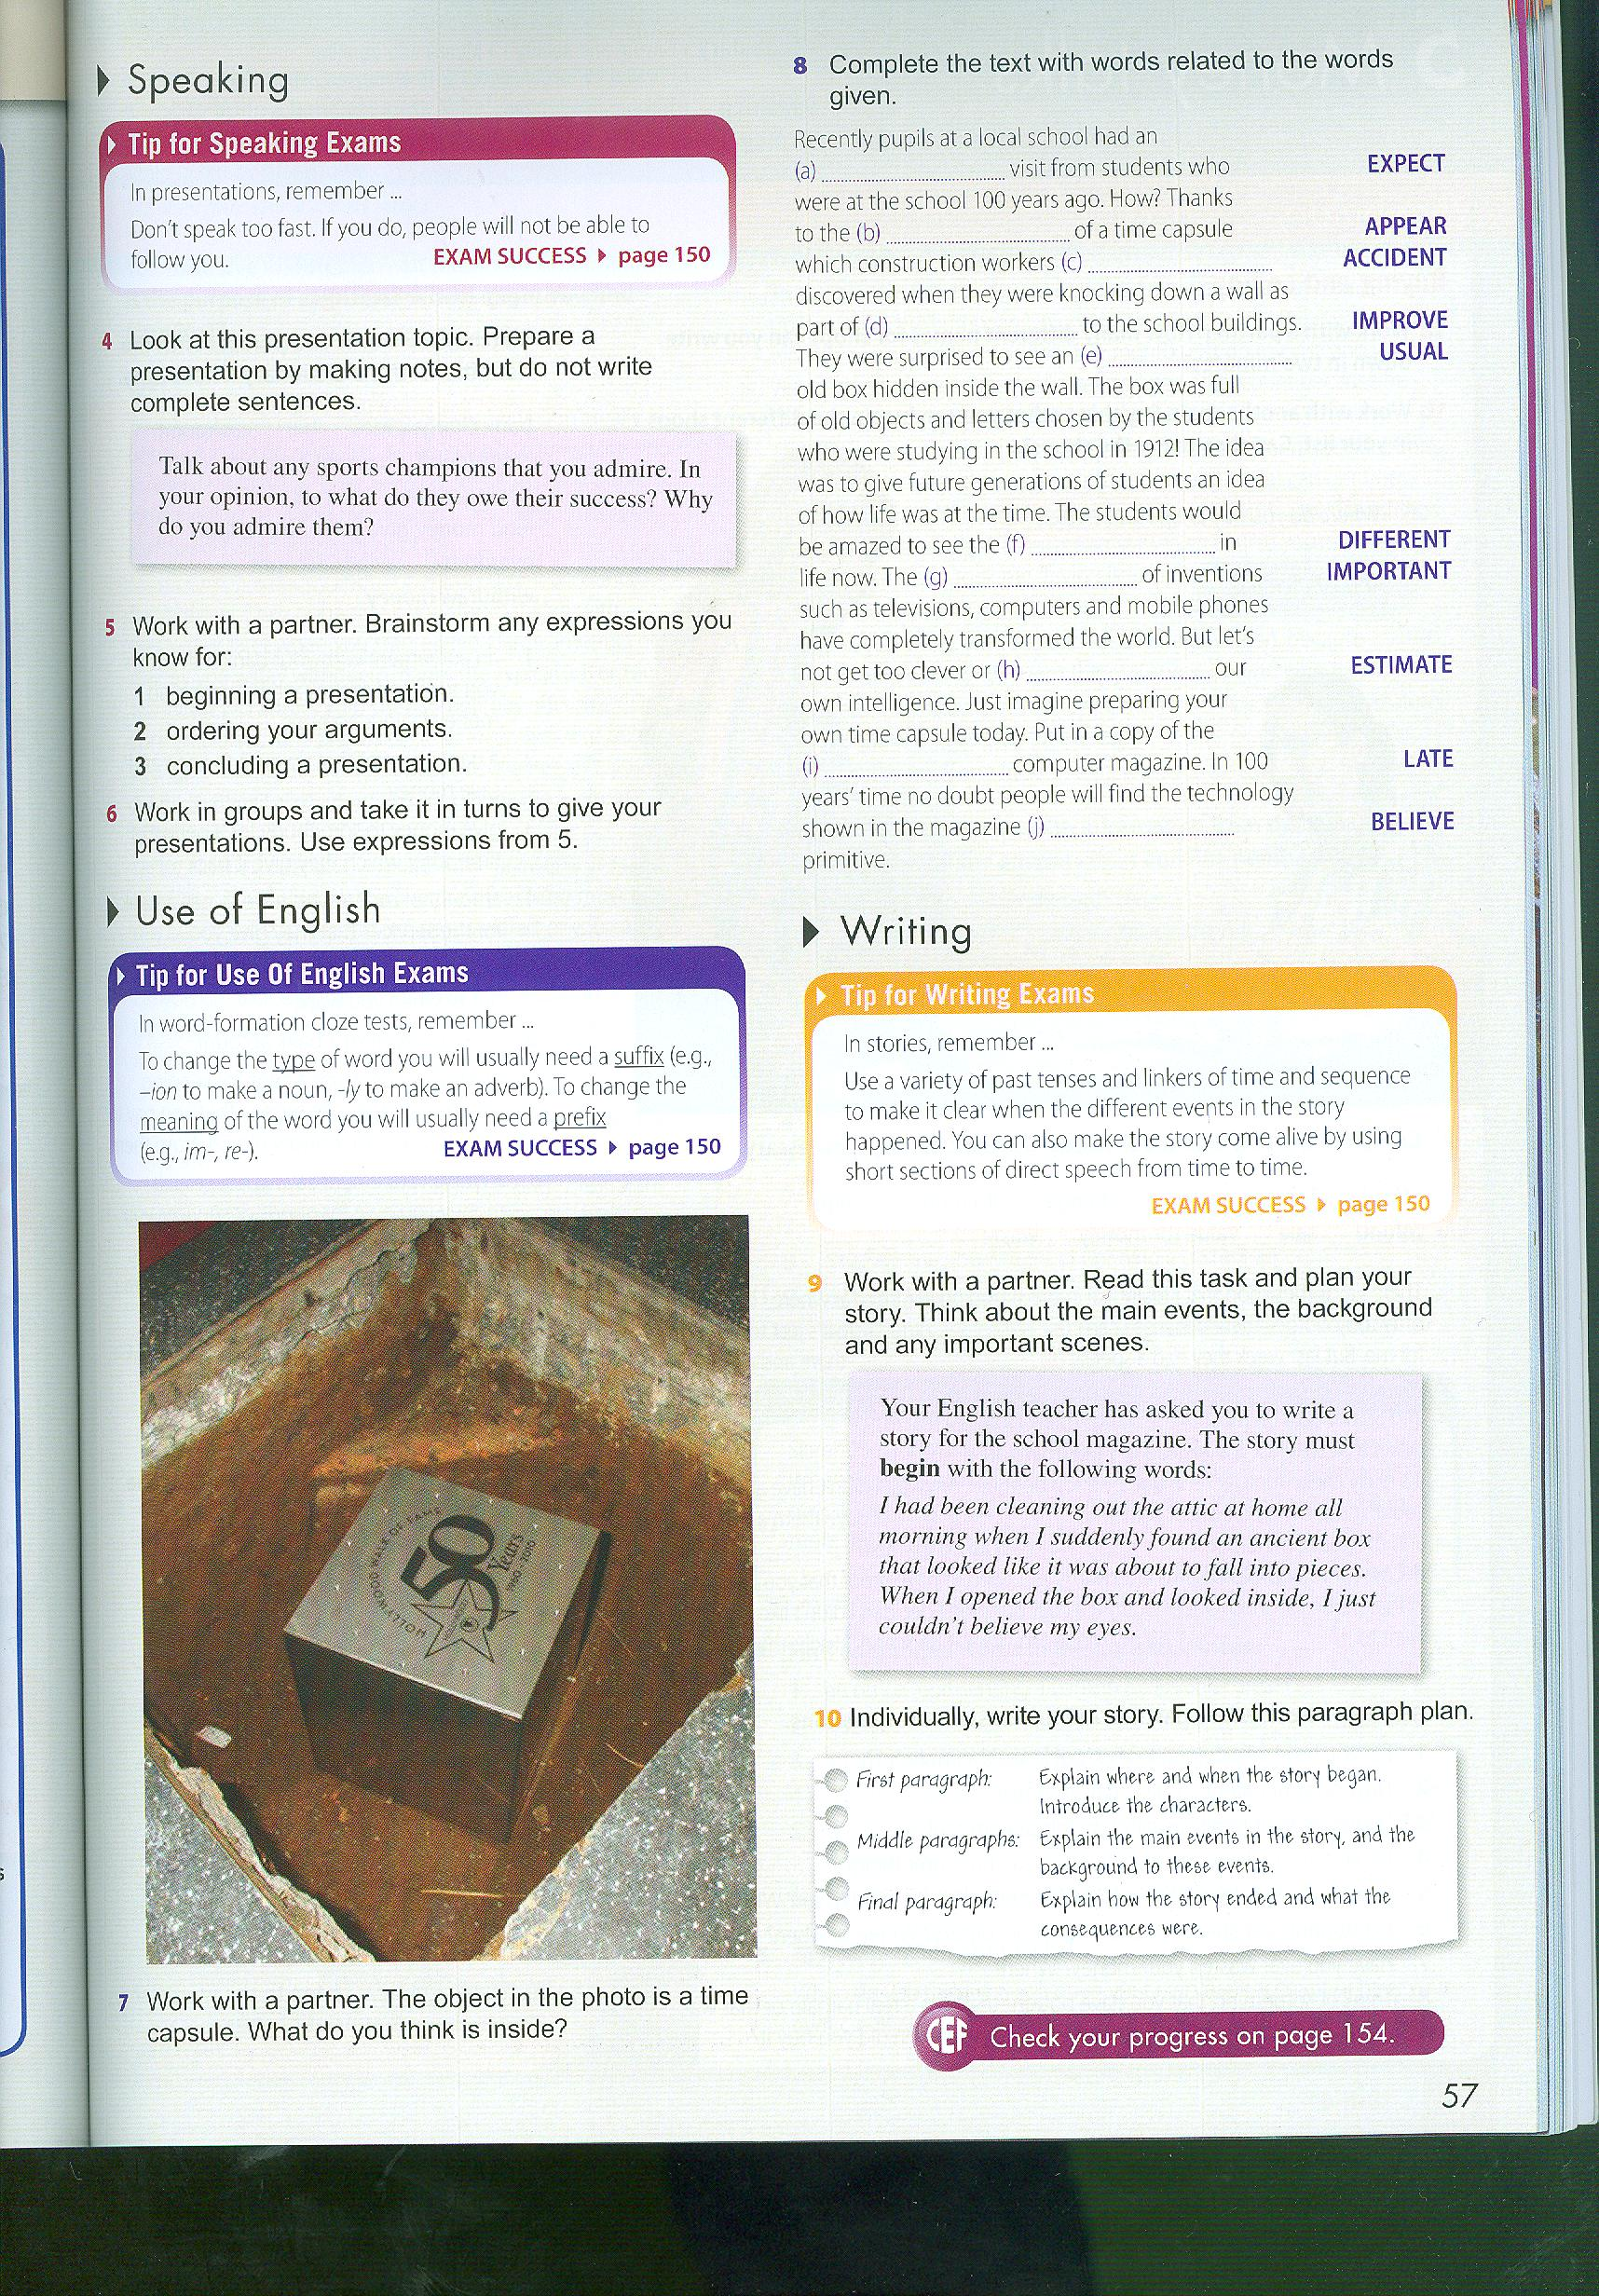
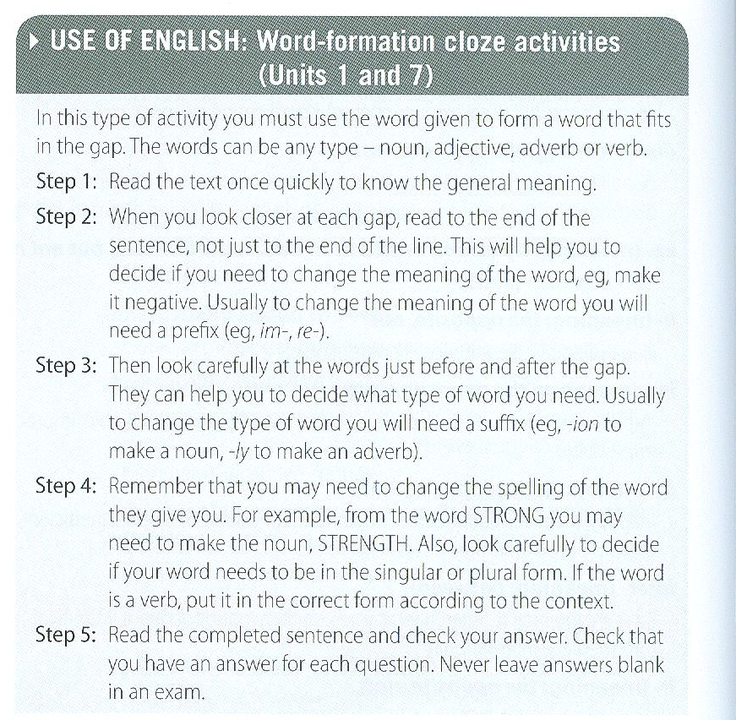

Slide 40
Exam Advice T/F Quiz – Word Formation
Remember to read the task in detail first then go right to the words.
You can use suffixes but not prefixes in the word formation section.
Looking at the words before and after the gap will give you the answer.
Remember you may need to change the spelling of the word – e.g. STRONG – STRENGTH.
When you have finished your writing, read through to check for mistakes.
Spelling isn’t important for word formation – if you are close you’ll get the mark.

Slide 41
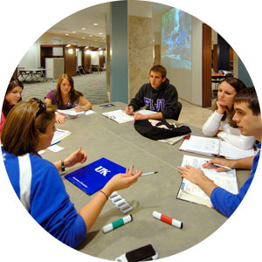
“I think this must be advice for the multiple-choice reading part because…..”
“This is from the speaking part of the exam, it could be part 1…….”

Slide 42
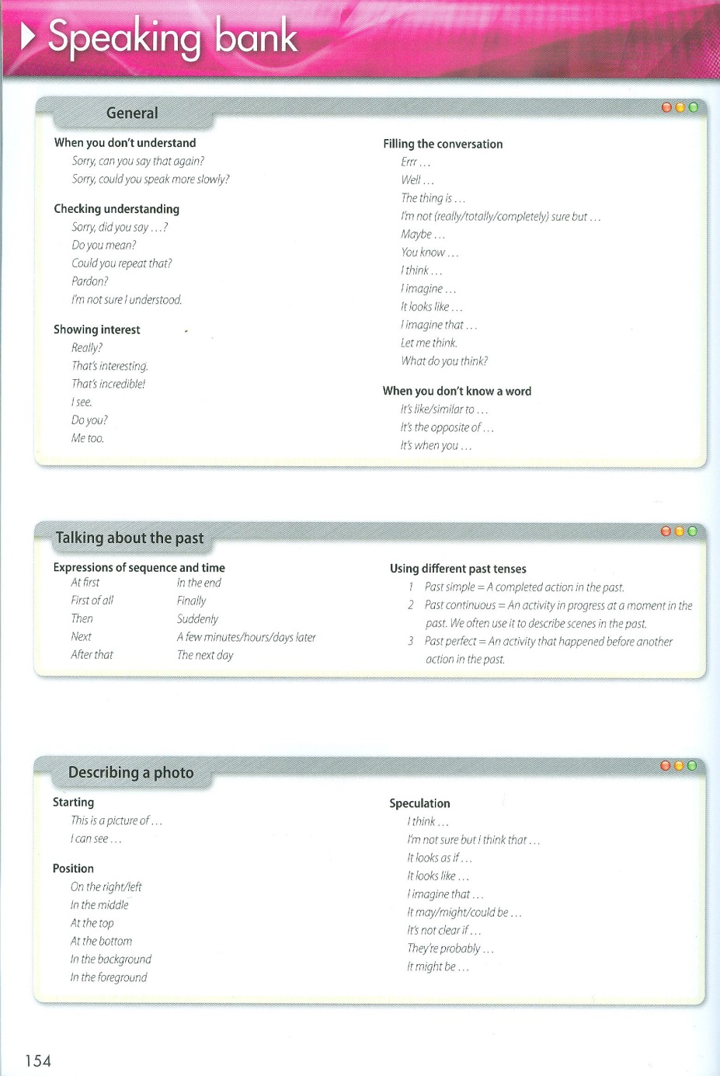
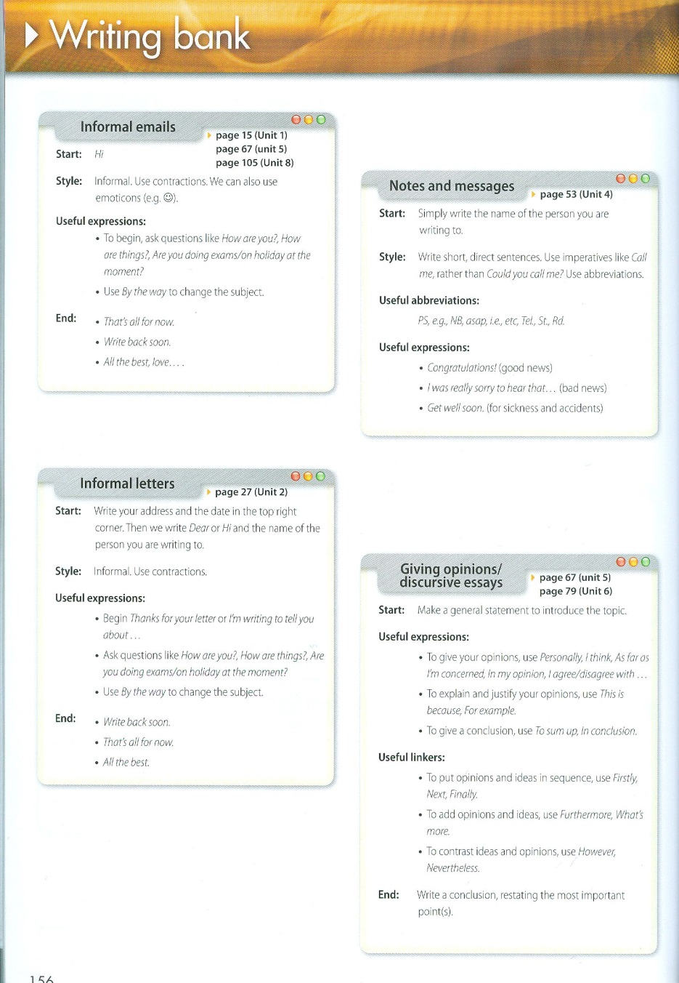

Slide 43
Speaking and writing: functions categories
Describing pictures | Giving opinions | Agreeing | Disagreeing
Informal letters | Formal letters | Narratives / stories | Polite requests
Furthermore Next / then I’m not so sure Could you possibly…?
On the left Absolutely Personally Finally I see what you mean, but…
Thanks for your letter! All of a sudden Dear…… Would you mind…….?
In my view Moreover It looks as if / though See you soon!

Slide 44
Speaking and writing: functions categories
Describing pictures | Giving opinions | Agreeing | Disagreeing
On the left It looks as if / though | Personally In my view | Absolutely | I’m not so sure I see what you mean, but…
Informal letters | Formal letters | Narratives / stories | Polite requests
Thanks for your letter! See you soon! | Furthermore Dear…… Moreover | Next / then Finally All of a sudden | Could you possibly…? Would you mind…….?
Furthermore Next / then I’m not so sure Could you possibly…?
On the left Absolutely Personally Finally I see what you mean, but…
Thanks for your letter! All of a sudden Dear…… Would you mind…….?
In my view Moreover It looks as if / though See you soon!

Slide 45
4. Work with complete answers

Slide 46
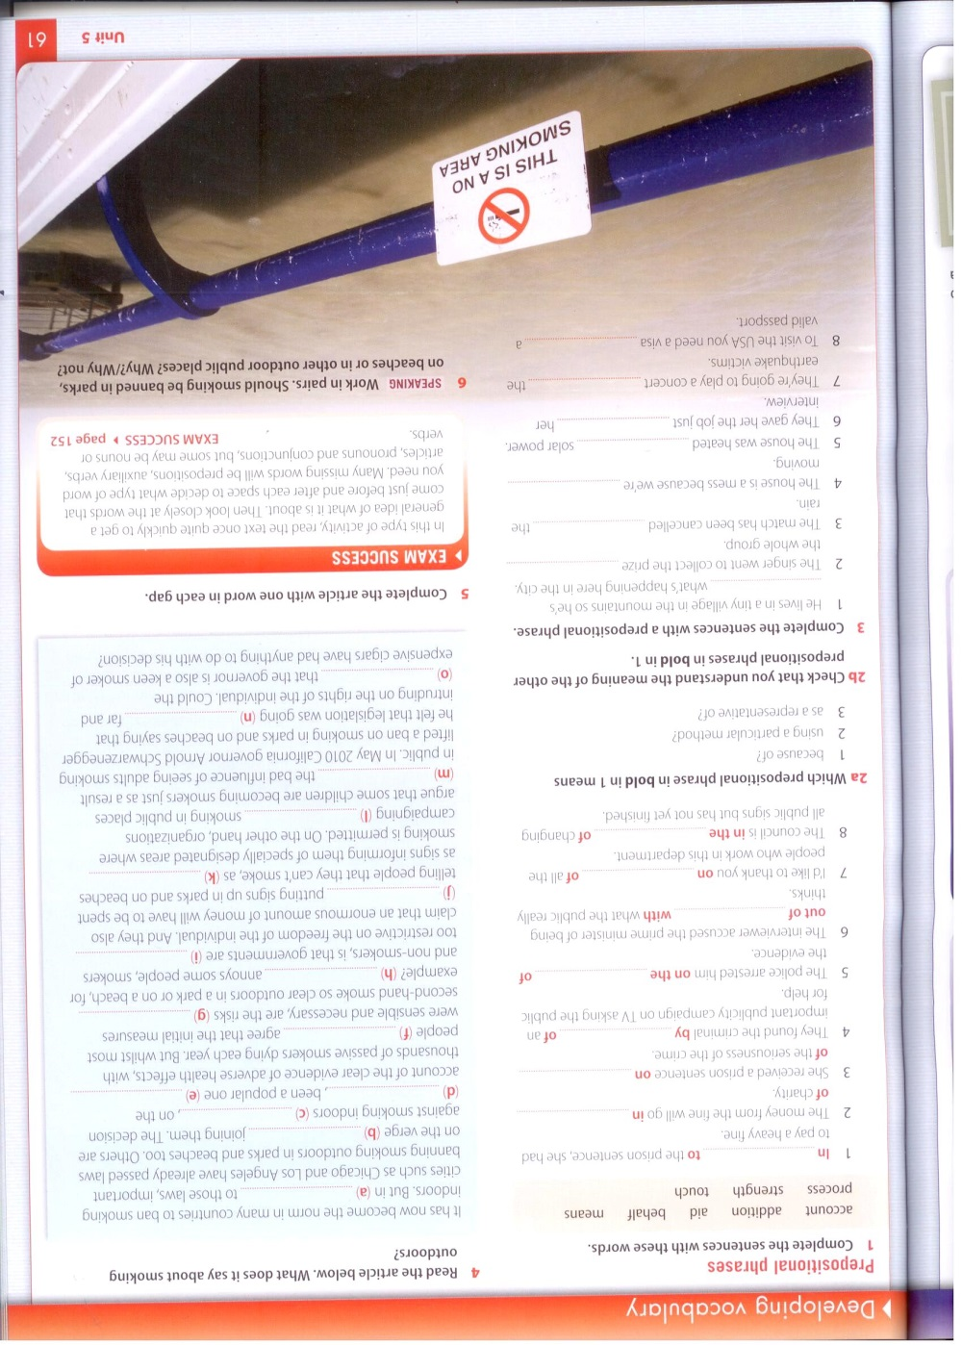

Working with answers: Use of English

Slide 47
Working with answers: Use of English
It has now become the norm in many countries to ban smoking indoors. But in addition to those laws, important cities such as Chicago and Los Angeles have already passed laws banning smoking outdoors in parks and beaches too. Others are on the verge of joining them. The decision against smoking indoors has, on the whole, been a popular one, on account of the clear evidence of adverse health affects, with thousands of passive smokers
Which words would you remove?
Which words would be removed to test: articles; preposition; tenses; linkers…?
Choose 5 words to remove to test your partner.

Slide 48
It has now become the norm in many countries to ban smoking indoors. But in addition to those laws, important cities such as Chicago and Los Angeles have already passed laws banning smoking outdoors in parks and beaches too. Others are on the verge of joining them. The decision against smoking indoors has, on the whole, been a popular one, on account of the clear evidence of adverse health affects, with thousands of passive smokers dying each year. But whilst
Which words were removed for the test?
What type of words are they?
What is being tested?

Slide 49
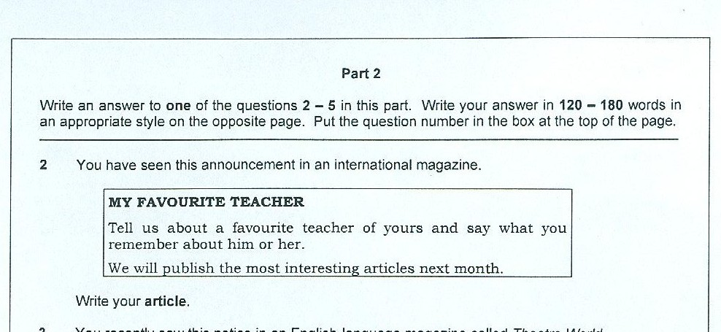
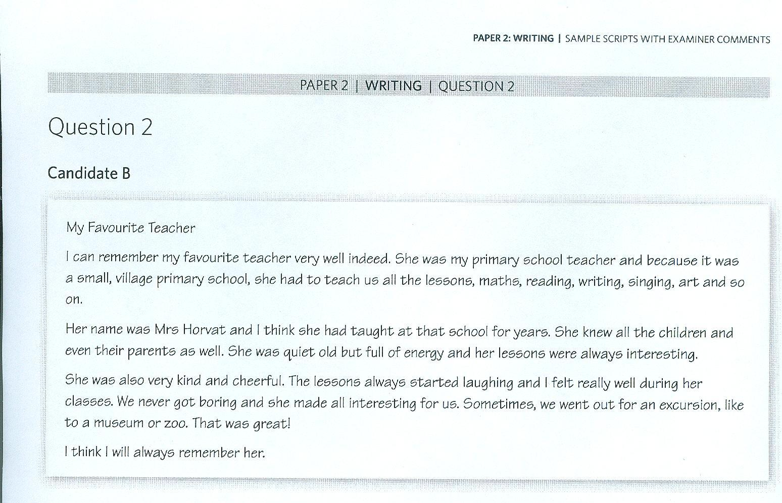
Work with answers - writing

Slide 50
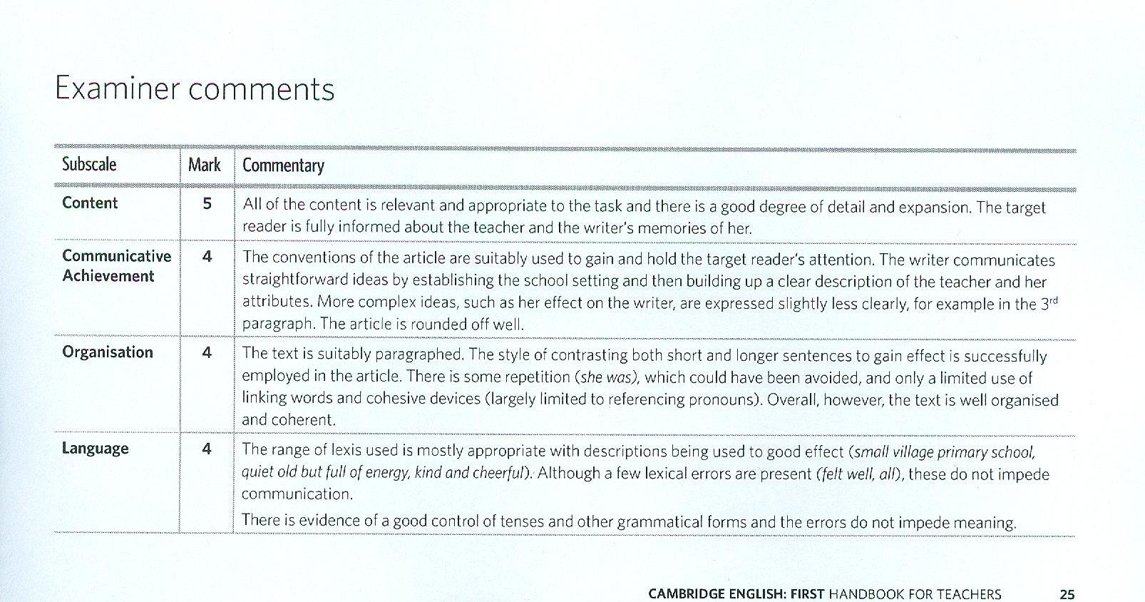

Slide 51
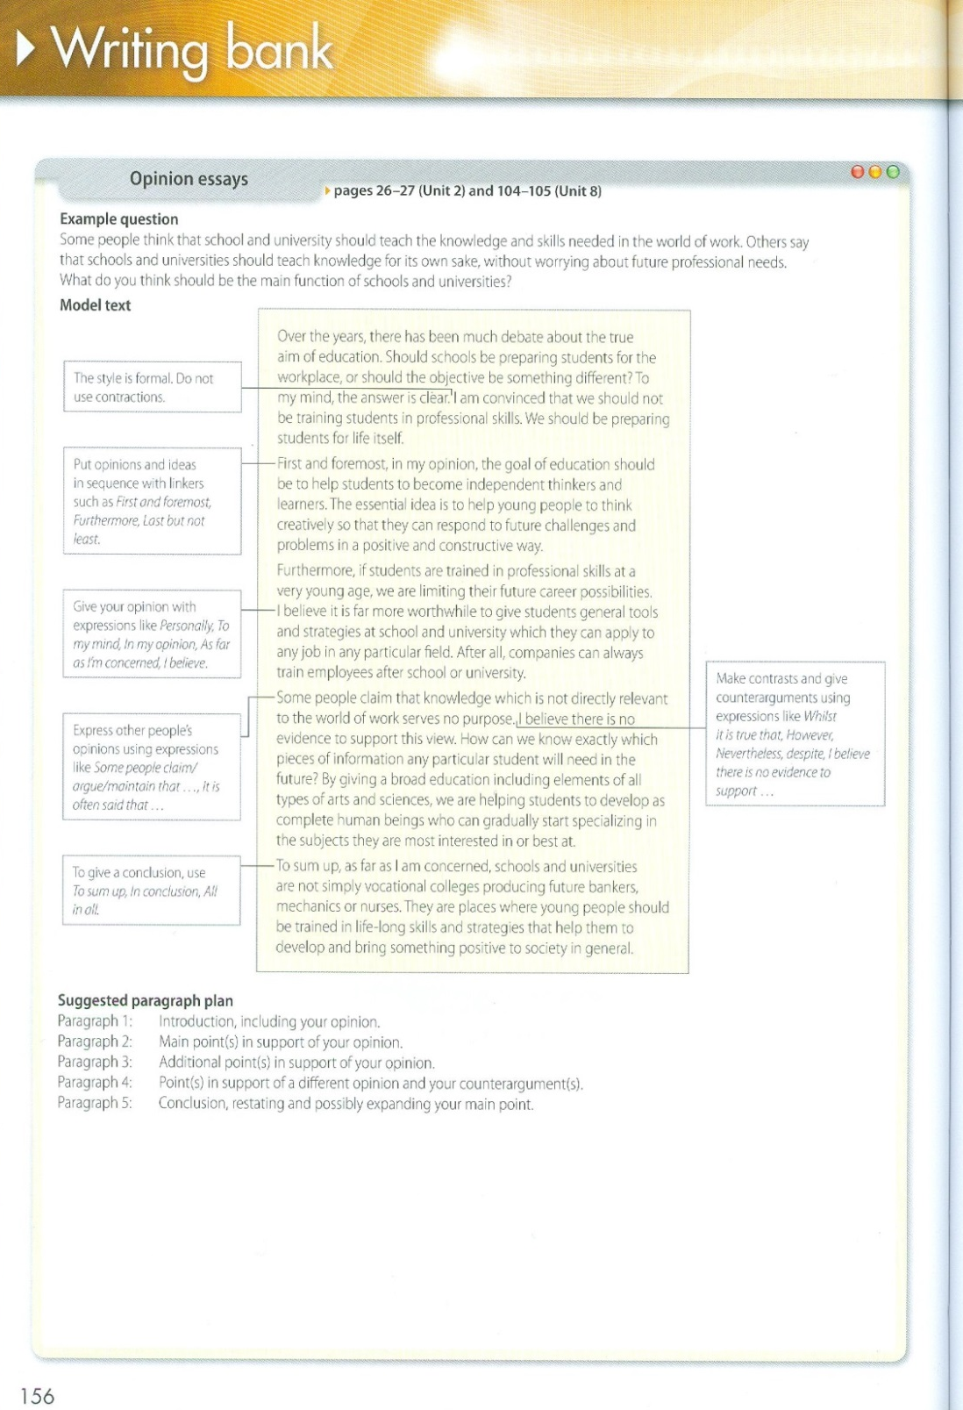
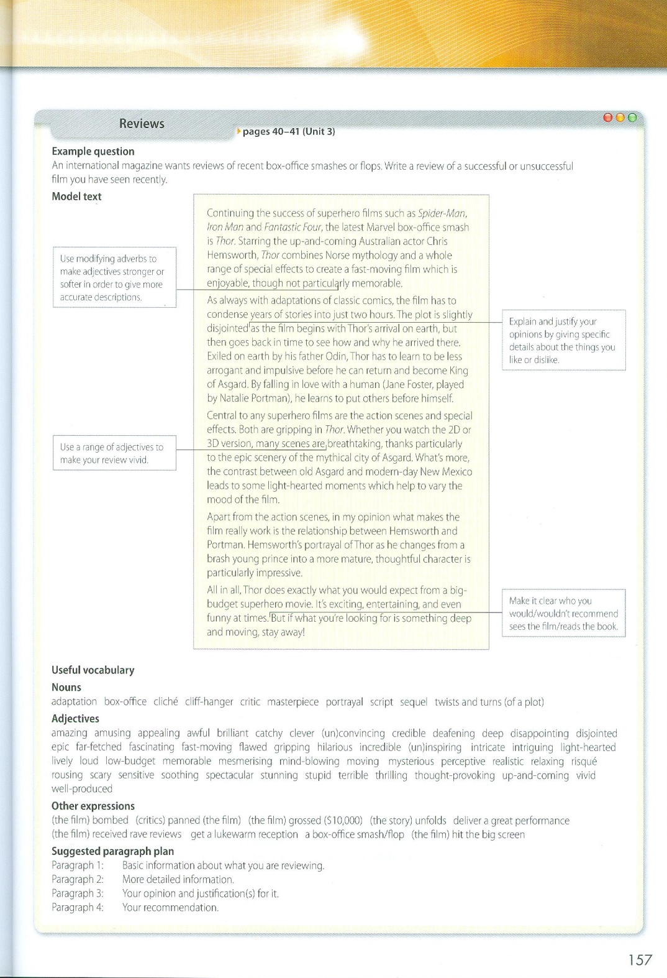

Slide 52
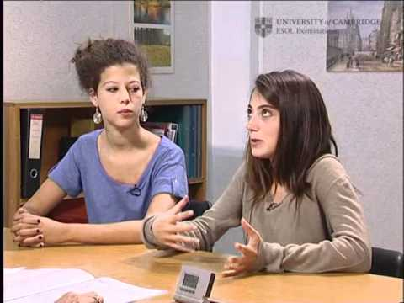

Speaking: video clips from exams

Slide 53
5. Build independent study skills

Slide 54


Slide 55
Guessing meaning from context
She nordled her final exams because she hadn’t prepared well.
He was wearing jeans, a t-shirt and a pair of galvies.
Francesca is a very snorpy person – terrible things are always happening to her.
She toogled into the classroom and told everyone the news.

Slide 56



Slide 57

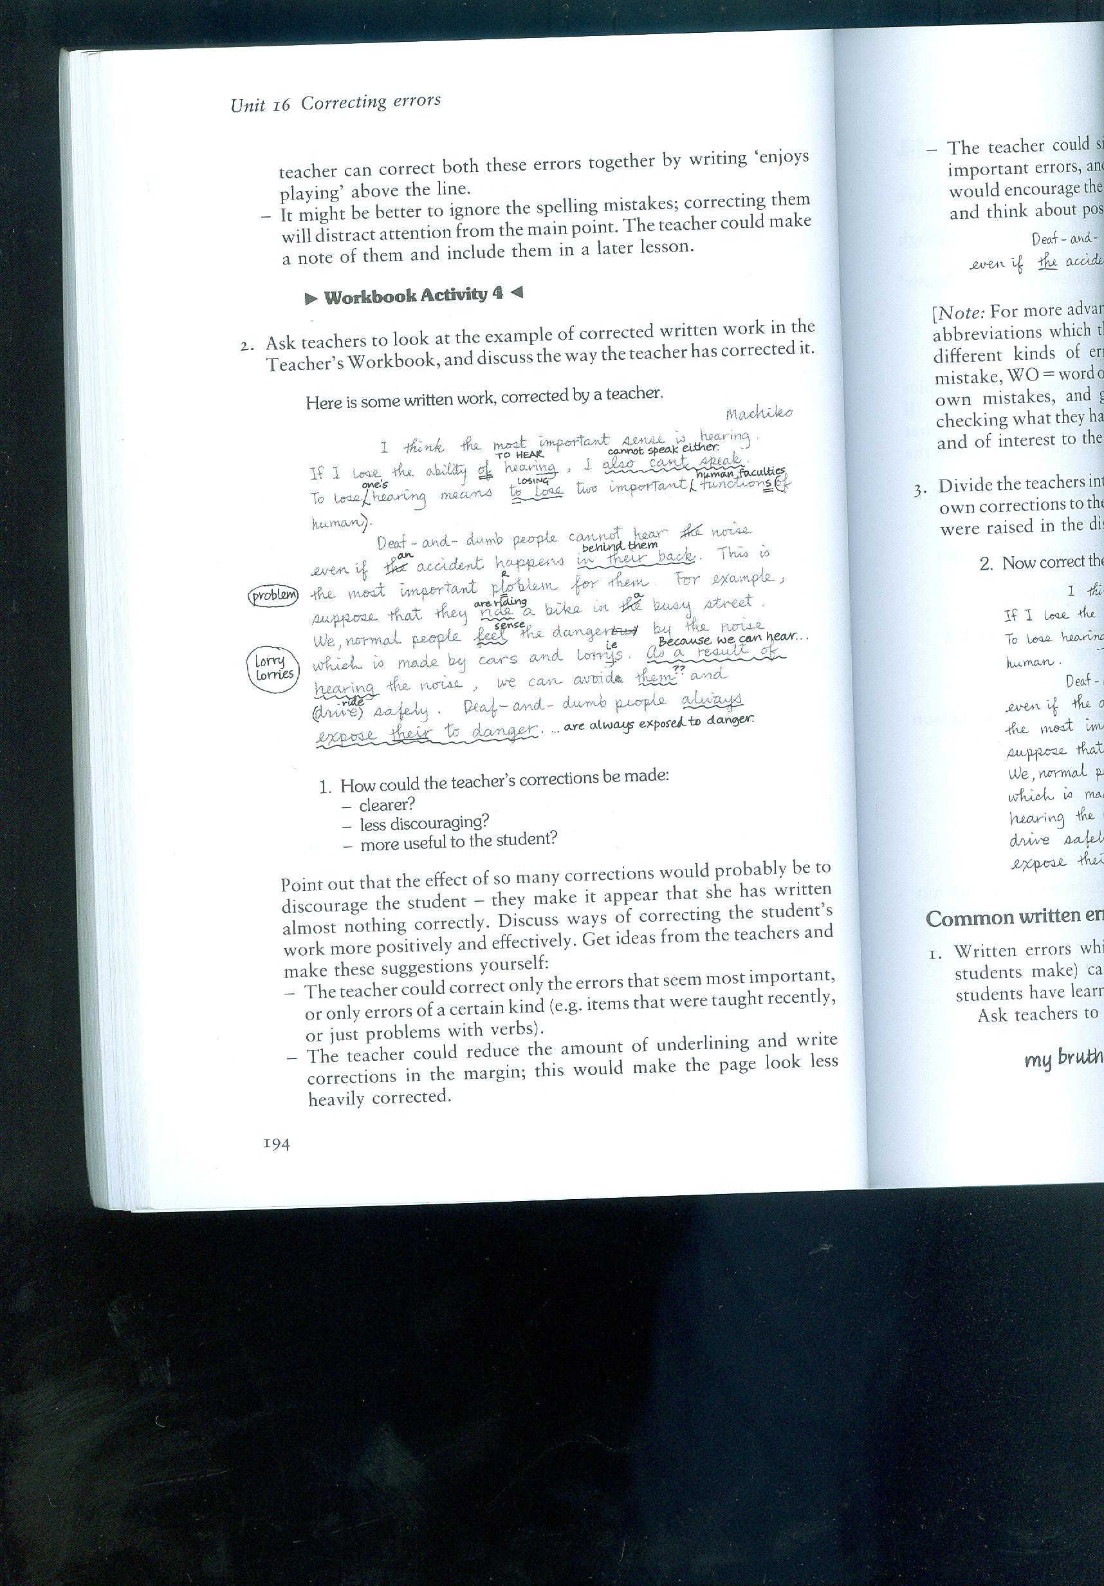
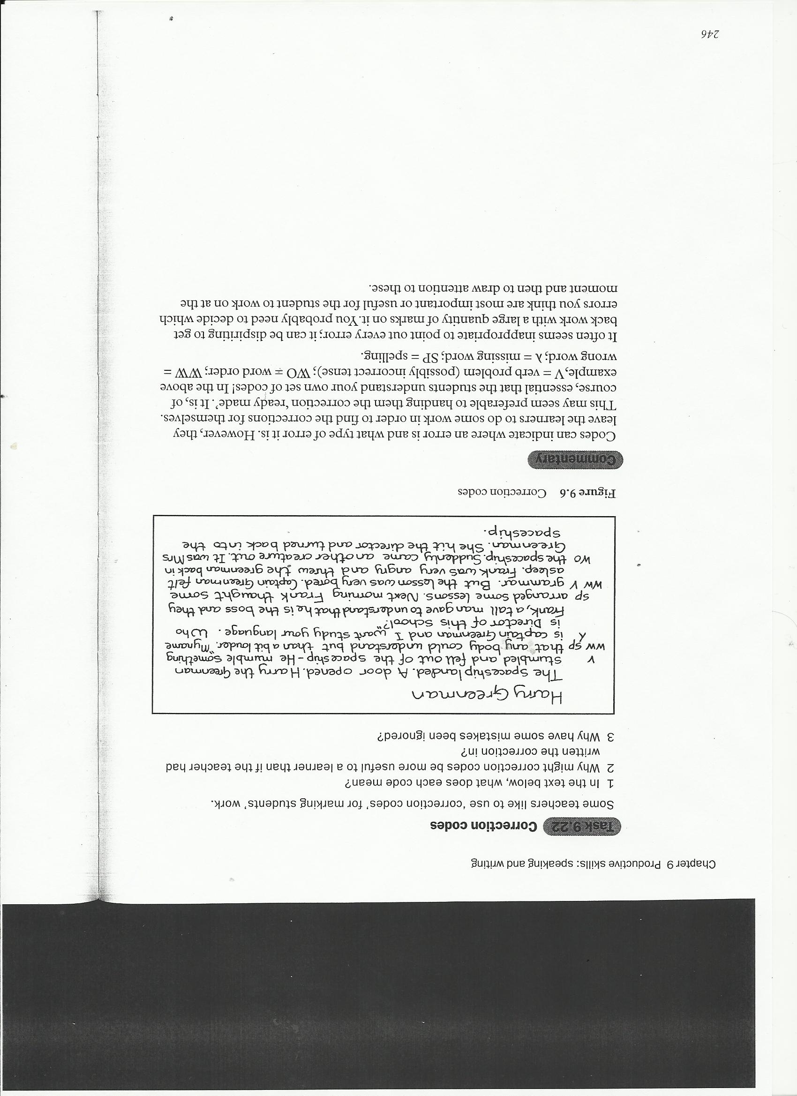
Study skills

Slide 58
Correction code
v = verb tense
ww = wrong word
sp = spelling
wo = word order
= word needed

Slide 59
6. Give realistic feedback

Slide 60
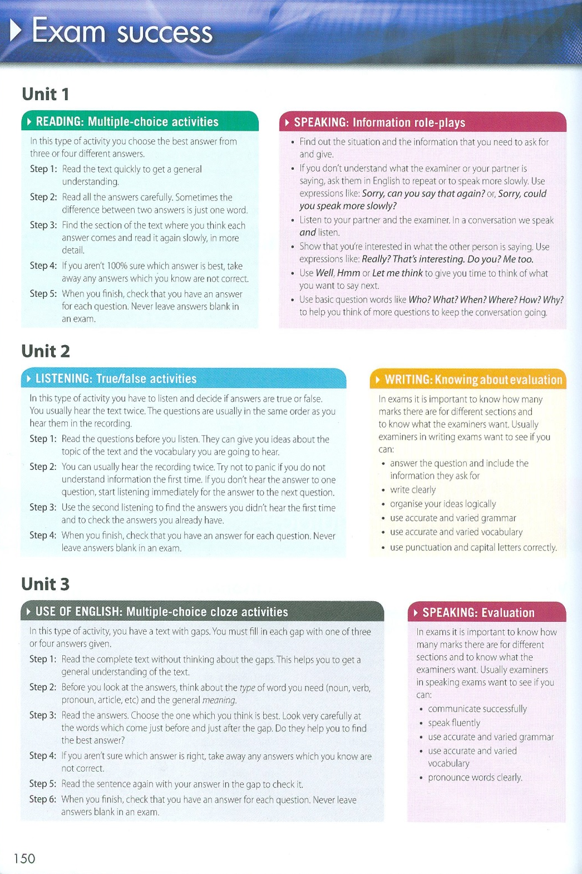

Slide 61
Feedback: know your criteria and terminology!
target reader
linking words & cohesive devices
discourse management
appropriacy
impede communication
conventions
coherent

Slide 62


Slide 63

7. Find a balance between teaching the test and teaching the right language and skills

Slide 64

Can I speak French?
“I studied French at school for 5 years – I got an ‘A’.”
“Oh, your French must be good.”
“Er………….oui?”

Slide 65
Maintaining interest and avoiding the ‘backwash effect’:
“Negative backwash from too much testing makes good language teaching more difficult.”
Oxford ELT Journal

Slide 66
Maintaining interest:
Relevant
Stimulating
Cross-curricular
Content-rich

Slide 67
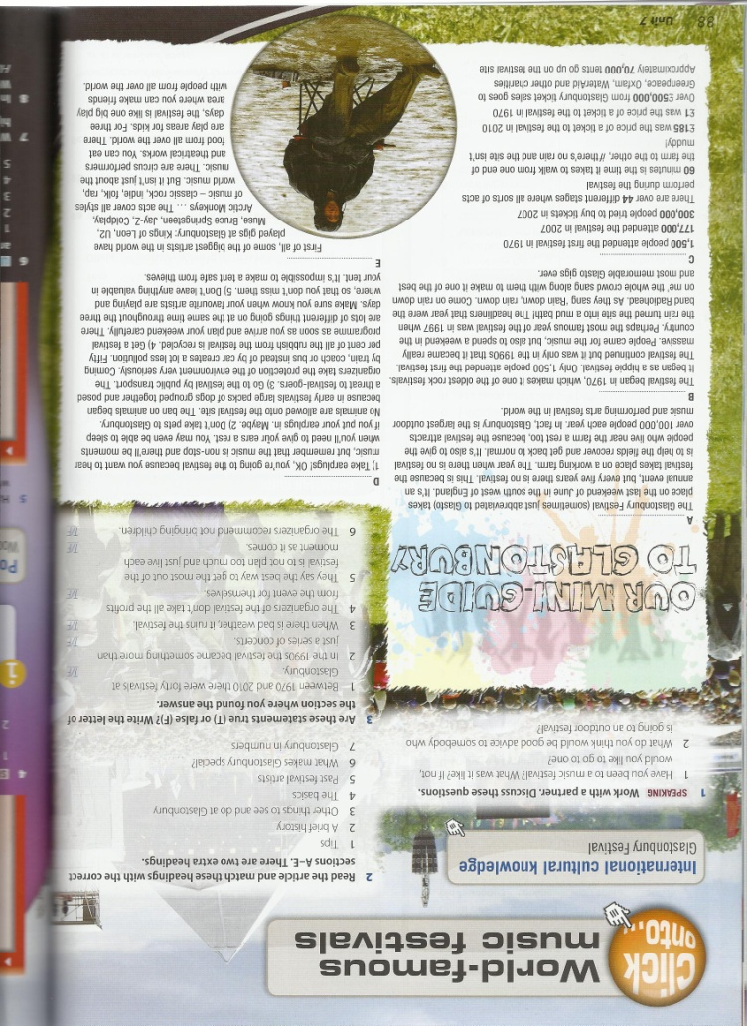
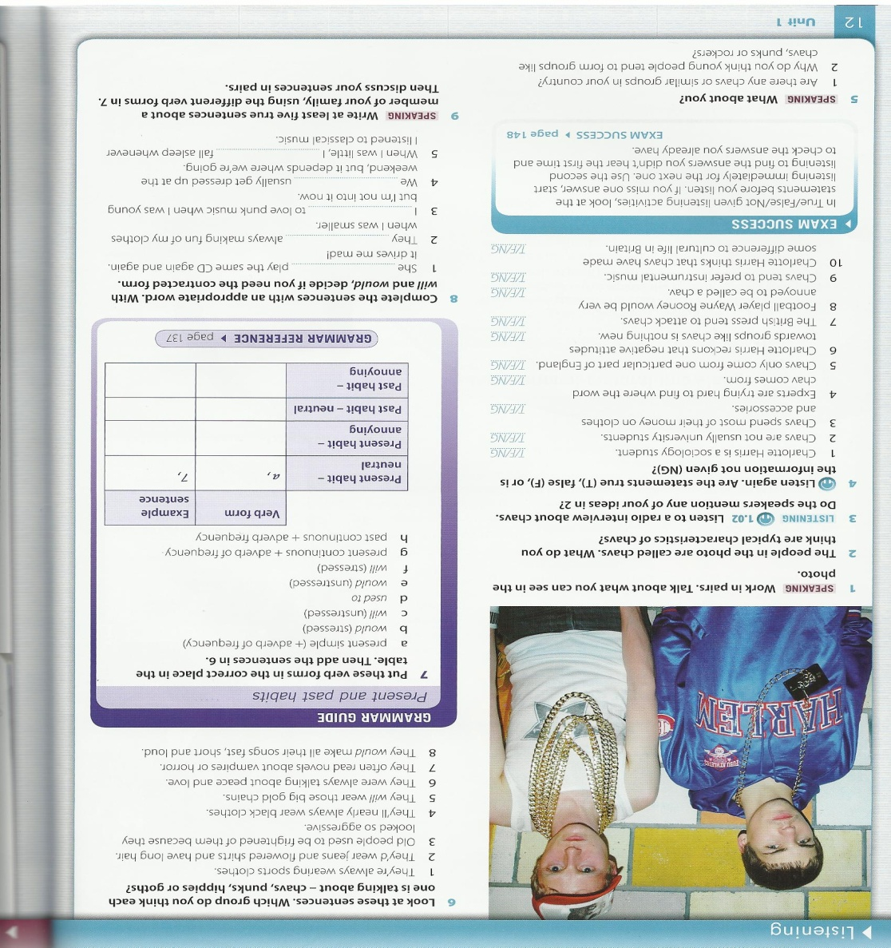
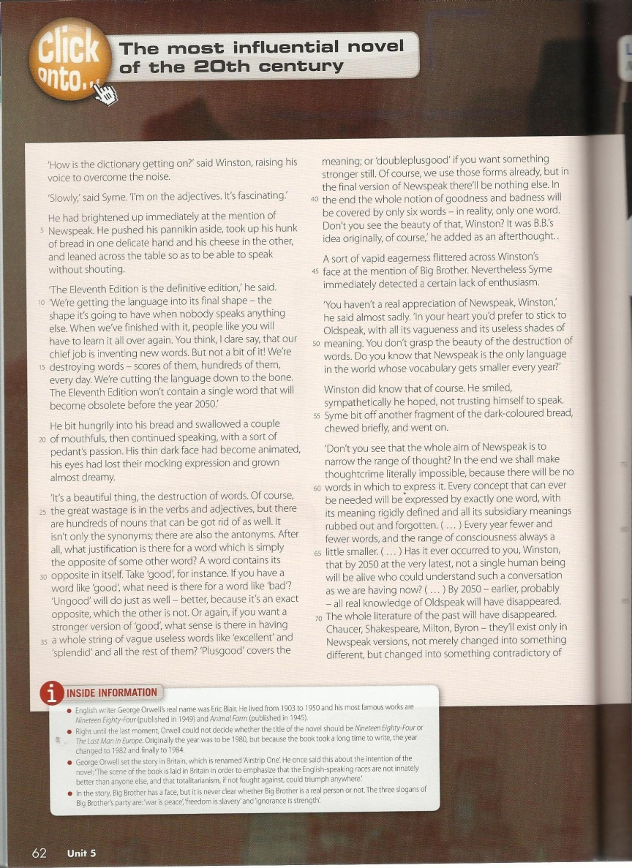
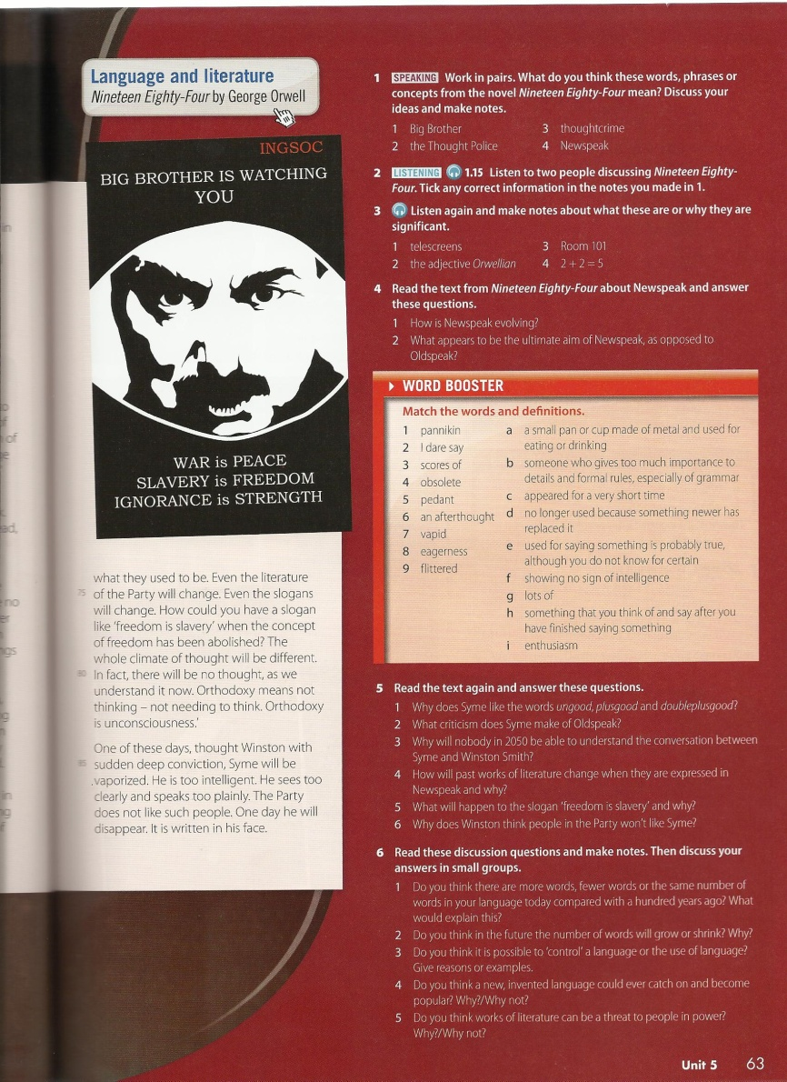
Why is Glastonbury famous?
What is a ‘chav’?
Why is the year 1984 significant?

Slide 68
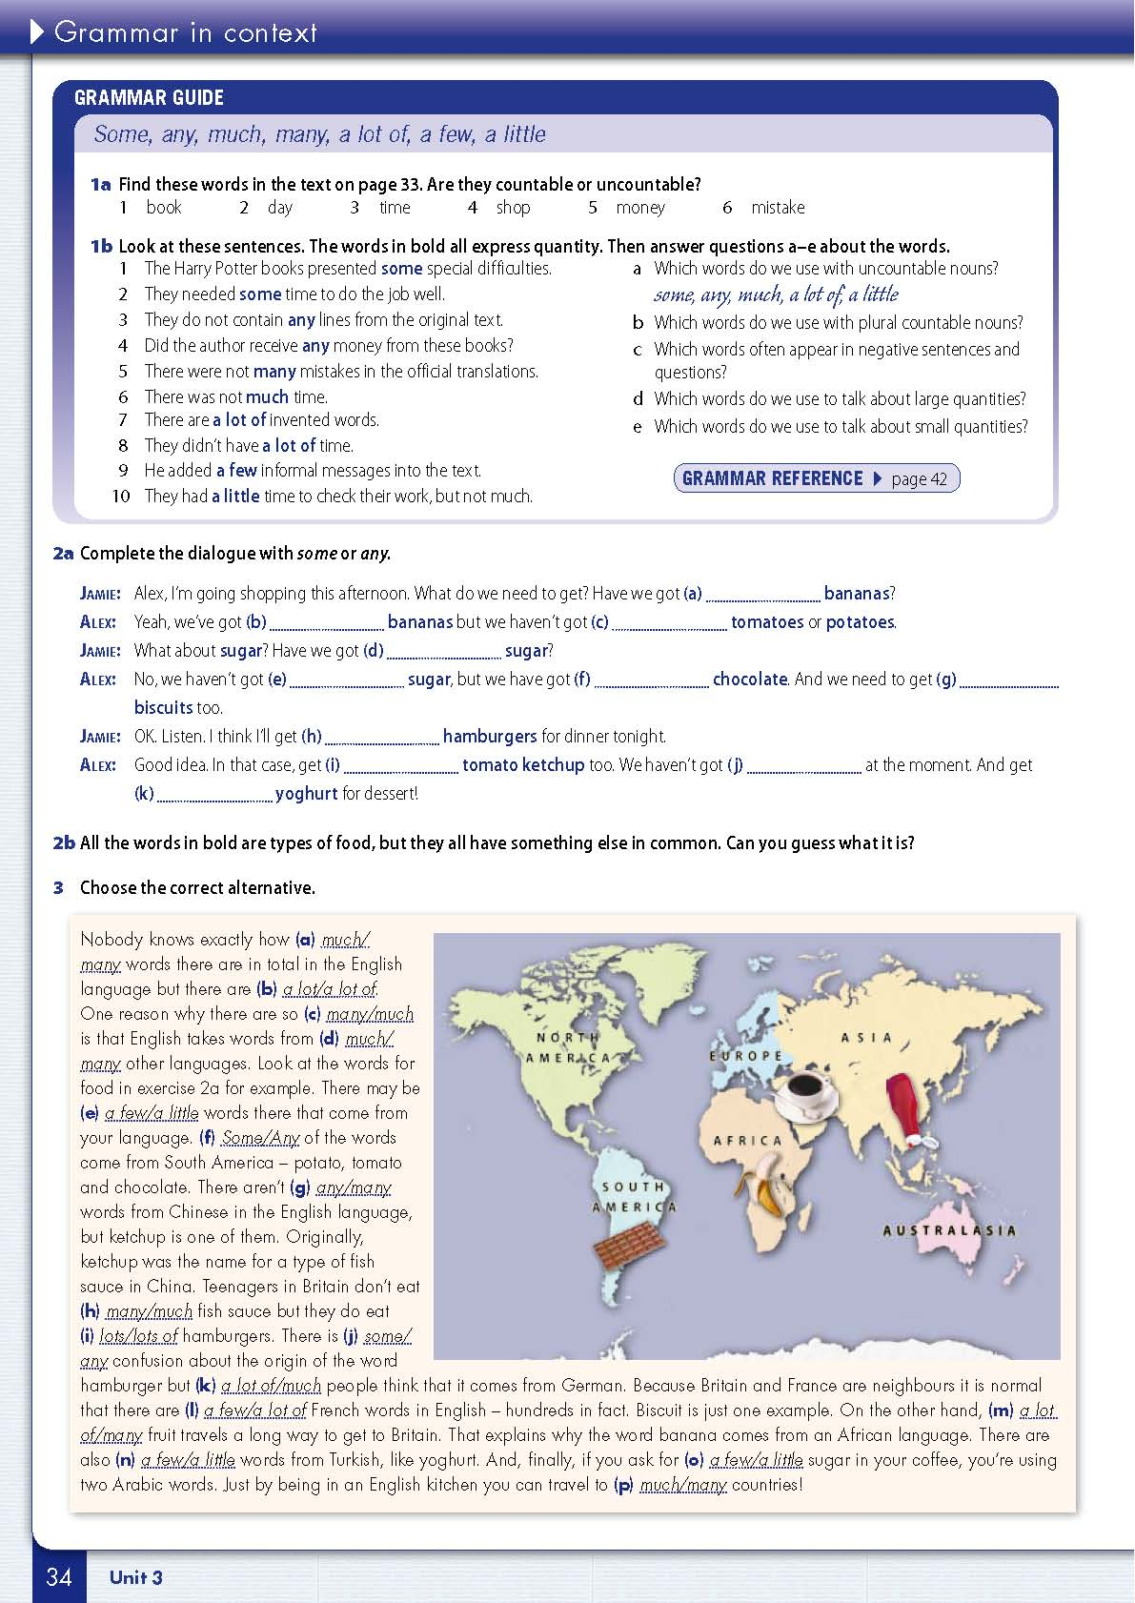
Grammar in context
Grammar in context
Notes:
The target grammar in each unit is given meaningful context through the reading and listening texts. Using a guided discovery approach, students follow the questions to work out the use and form of the grammar in question with contextual hints to help them along.
Students are directed to the Language Reference Section at the end of every unit to check their findings and grammatical hypotheses. These reference pages bring together all the grammar and vocabulary taught in the unit, making it much easier for student to revise and prepare for exams.

Slide 69
Don’t forget – you can still use games!

Slide 70
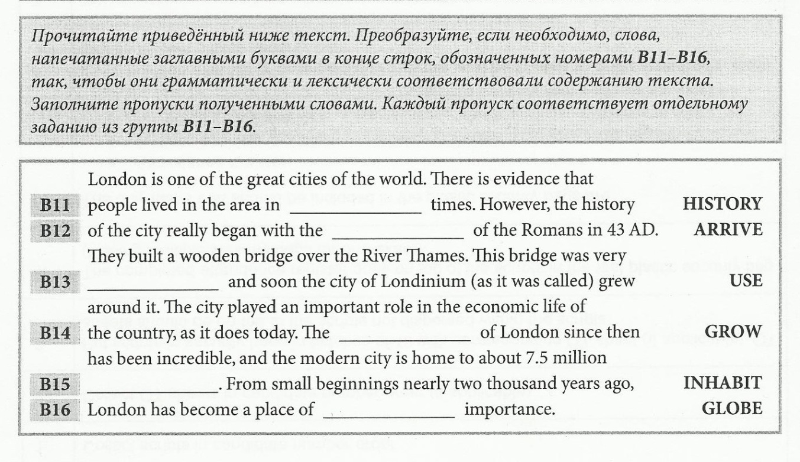
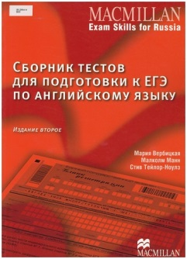

Slide 71

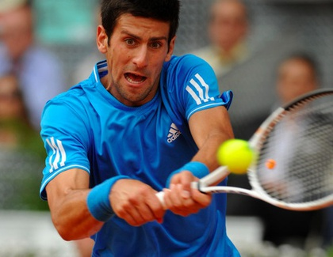
Word formation tennis
use

Slide 72

Word formation tennis
expect

Slide 73



Slide 74




$100
The period of life when you change from a child to a
young adult is:
a. childhood
b. adolescence
c. teenagehood
d. middle-age

Slide 75
$100
The period of life when you change from a child to a
young adult is:
b. adolescence

Slide 76
$100
The period of life when you change from a child to a
young adult is:
b. adolescence
$500
Your wife/husband’s sister is your:
sister-in-life
sister-in-marriage
sister-in-legal
sister-in-law

Slide 77
$100
The period of life when you change from a child to a
young adult is:
b. adolescence
$500
Your wife/husband’s sister is your:
d. sister-in-law

Slide 78
$100
The period of life when you change from a child to a
young adult is:
b. adolescence
$500
Your wife/husband’s sister is your:
d. sister-in-law
$1000
Someone without any brothers or sisters is a(n):
a. single child
b. only child
c. sole child
d. lonely child

Slide 79
$100
The period of life when you change from a child to a
young adult is:
b. adolescence
$500
Your wife/husband’s sister is your:
d. sister-in-law
$1000
Someone without any brothers or sisters is a(n):
b. only child

Slide 80
REMEMBER…
Exam tasks are similar across exams
There is a definite ‘skills overlap’ for many exams
There are universal rules for exam success
Find a balance: testing, training and teaching

Slide 81
Good luck with your exam groups

Slide 82


A unique opportunity in Russia
www.iptrussia.ru
English UK Diploma in ELT Management (DELTM)
Key professional development if planning a career in EFL
Fully recognised ELT management qualification
Distance learning and face-to-face seminars with experienced teacher trainers from UK
All management and leadership areas covered

Slide 83
A unique opportunity in Russia with IPT International Professional Training
info@iptrussia.ru
www.iptrussia.ru
‘Like’ us on facebook and vk

Slide 84
Spelling backwards

Slide 85
Just say yes

