Slide 1
Building Fluency with Gateway
Tom Wiseman | co-founder of English Connection

Slide 2
What do students need to be prepared for?
Immediate Goals: The next lesson/text
Mid-term Goals: Olympiad, ОГЭ, ЕГЭ
Long-term Goals: Life

Slide 3
We have to prepare our students to perform under pressure!

Slide 4
0%
100%
Understanding
Speaking

Slide 5
Increasing Difficulty and Independence
0%
100%

Slide 6
Increasing Difficulty and Independence
0%
100%
Establish Understanding

Slide 7
Increasing Difficulty and Independence
0%
100%
Establish Understanding

Slide 8
Increasing Difficulty and Independence
0%
100%
Establish Understanding
Test Fluency (Speaking)

Slide 9
Increasing Difficulty and Independence
0%
100%
Establish Understanding
Test Fluency (Speaking)

Slide 10
Increasing Difficulty and Independence
0%
100%
Establish Understanding
AUTOMATE
Test Fluency (Speaking)

Slide 11
3rd Conditional
If + had(n’t) + V3, would(n’t) + have + V3
A Different Past

Slide 12
3rd Conditional
If + had(n’t) + V3, would(n’t) + have + V3
A Different Past

Slide 13
3rd Conditional
If + had(n’t) + V3, would(n’t) + have + V3
A Different Past

Slide 14
Я пошёл в магазин потому, что у нас не было молока.

Slide 15
СВ
Я пошёл в магазин потому, что у нас не было молока.
= пошла

Slide 16
Где? = Предложный падеж
(Я был в магазине)
СВ
Вин. падеж
Я пошёл в магазин потому, что у нас не было молока.
(куда?)
= пошла

Slide 17
Где? = Предложный падеж
(Я был в магазине)
СВ
Вин. падеж
Я пошёл в магазин потому, что у нас не было молока.
(куда?)
Родительный падеж
= пошла

Slide 18
Где? = Предложный падеж
(Я был в магазине)
СВ
Вин. падеж
(мы → нас)
Я пошёл в магазин потому, что у нас не было молока.
(куда?)
Родительный падеж
= пошла

Slide 19
Где? = Предложный падеж
(Я был в магазине)
СВ
Вин. падеж
(мы → нас)
Я пошёл в магазин потому, что у нас не было молока.
(куда?)
Родительный падеж
(не существует)
= пошла

Slide 20
Где? = Предложный падеж
(Я был в магазине)
Средний род
СВ
Вин. падеж
(мы → нас)
Я пошёл в магазин потому, что у нас не было молока.
(куда?)
Родительный падеж
(не существует)
= пошла

Slide 21
Где? = Предложный падеж
(Я был в магазине)
Родительный падеж
Средний род
СВ
Вин. падеж
(мы → нас)
Я пошёл в магазин потому, что у нас не было молока.
(куда?)
Родительный падеж
(не существует)
= пошла

Slide 22
3rd Conditional
If + had(n’t) + V3, would(n’t) + have + V3
A Different Past
Too Slow!!!

Slide 23
3rd Conditional
If + had(n’t) + V3, would(n’t) + have + V3
A Different Past

Slide 24
Increasing Difficulty and Independence
0%
100%
Establish Understanding
AUTOMATE
Test Fluency (Speaking)

Slide 25
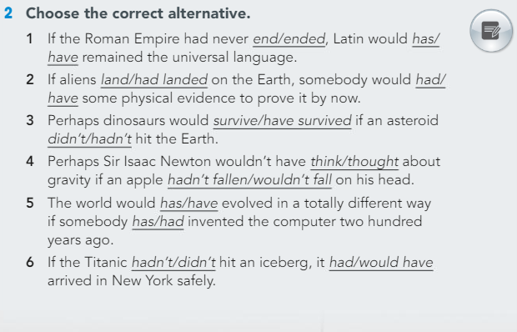
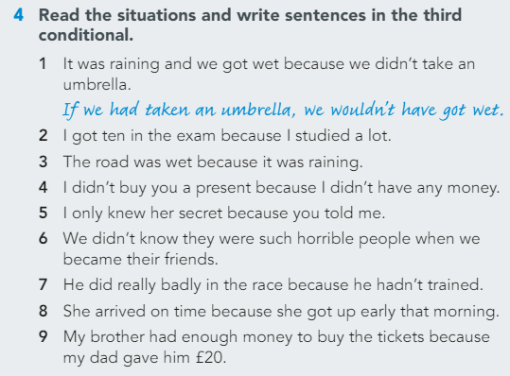
Establish Understanding (Gateway B1+)

Slide 26
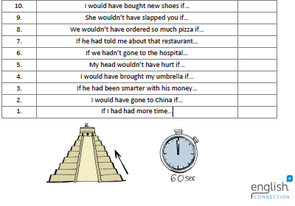
Automate

Slide 27
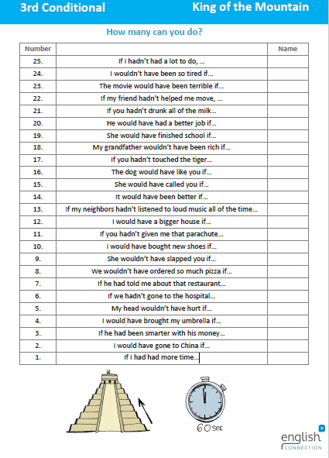

Slide 28
Why does it work?
Includes competition (and fun!)
Shows improvement
Provides a distraction/goal from laborious logic

Slide 29
What’s holding students back?
Problem
Accuracy
Fluency
Hesitation
Worry
High
Low
Lack of attention to detail
Low
High

Slide 30
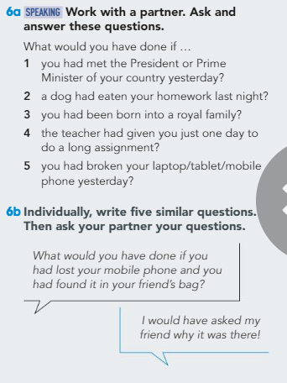
Test Fluency (Speaking)

Slide 31
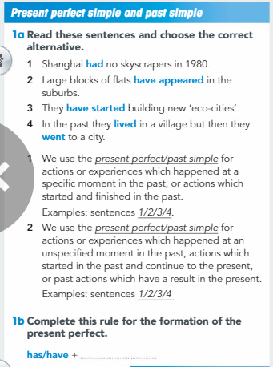
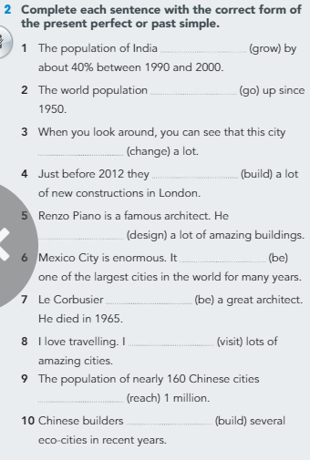
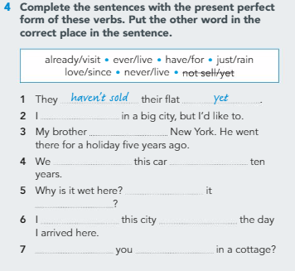
Present Perfect vs. Past Simple
Establish Understanding

Slide 32
Automate (I do…)
since before you were born | since 2000 | last summer
3 weeks ago | since yesterday morning | since my last birthday
since last Monday | a month ago | since March
yesterday at lunchtime | all week last week | last weekend

Slide 33
Automate (Have you…? / Did you…?)
since before you were born | since 2000 | last summer
3 weeks ago | since yesterday morning | since my last birthday
since last Monday | a month ago | since March
yesterday at lunchtime | all week last week | last weekend
eat my lunch | build robots | learn how to play the piano
study Chinese | do homework | read books
eat cake | make sushi | ride horses
go skating | walk in the park | wear shoes

Slide 34
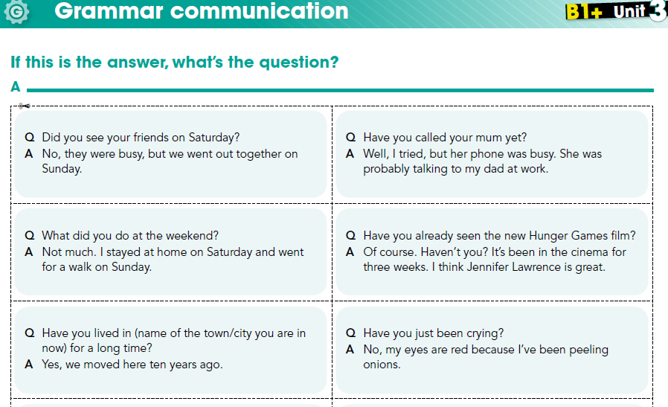
Testing Fluency with Gateway

Slide 35
Assessing Ability
Did the students use or avoid the Target Language when given the opportunity?
How much/often do we need to review?
Check if they use it in future speaking activities.

Slide 36
Principles of Fluency
Ability to improvise shows true fluency
Greater variation = Higher difficulty
ОГЭ, ЕГЭ, Cambridge Exams… Students need to be ready for anything!

Slide 37
In combination with Gateway, this build-up provides effective assessment and allows for efficient use of your time and resources.
Increasing Difficulty and Independence
0%
100%
Establish Understanding
AUTOMATE
Test Fluency (Speaking)

Slide 38
Building Fluency with Gateway
Tom Wiseman | co-founder of English Connection
Thomas.Wiseman.iv@englishconnect-spb.com

Slide 39
Bonus: Building Dexterity!

